Slide 1
Present tense of ser
Subject pronouns
In order to use verbs, you will need to learn about subject pronouns. A subject pronoun replaces the name or title of a person or thing and acts as the subject of a verb. In both Spanish and English, subject pronouns are divided into three groups: first person, second person, and third person.
ANTE TODO

Slide 2
Present tense of ser
Subject pronouns
SINGULAR
PLURAL
FIRST PERSON | yo | / | nosotros | we (masculine)
 |  |  | nosotras | we (feminine)
SECOND PERSON | tú | you (fam.) | vosotros | you (masc., fam.)
 | usted (Ud.) | you (form.) | vosotras | you (fem., fam.)
 |  |  | ustedes (Uds.) | you (form.)
THIRD PERSON | él | he | ellos | they (masc.)
 | ella | she | ellas | they (fem.)

Slide 3
Present tense of ser
Spanish has two subject pronouns that mean you (singular). Use tú when addressing a friend, a family member, or a child. Use usted to address a person with whom you have a formal or more distant relationship, such as a superior at work, a professor, or a person older than you.
Tú eres de Canadá, ¿verdad, David? You are from Canada, right, David? | Usted es la profesora de español? Are you the Spanish professor?

Slide 4
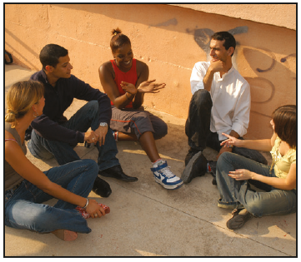
Present tense of ser
The masculine plural forms nosotros, vosotros, and ellos refer to a group of males or to a group of males and females. The feminine plural forms nosotras, vosotras, and ellas can refer only to groups made up exclusively of females.
nosotros, vosotros, ellos | nosotros, vosotros, ellos | nosotras, vosotras, ellas

Slide 5
Present tense of ser
There is no Spanish equivalent of the English subject pronoun it. Generally it is not expressed in Spanish.
Es un problema. It’s a problem. | Es una computadora. It’s a computer.

Slide 6
Present tense of ser
The present tense of ser
In Contextos and Fotonovela, you have already used several forms of the present tense of ser (to be) to identify yourself and others and to talk about where you and others are from. Ser is an irregular verb; its forms do not follow the regular patterns that most verbs follow. You need to memorize the forms, which appear in this chart.
ANTE TODO

Slide 7
Present tense of ser
The verb ser (to be)
yo | soy | I am
tú | eres | you are (fam.)
Ud./él / ella | es | you are (form.); he/she is
nosotros/as | somos | we are
vosotros/as | sois | you are (fam.)
Uds./ellos/ellas | son | you are (form.); they are
SINGULAR FORMS
PLURAL
FORMS

Slide 8
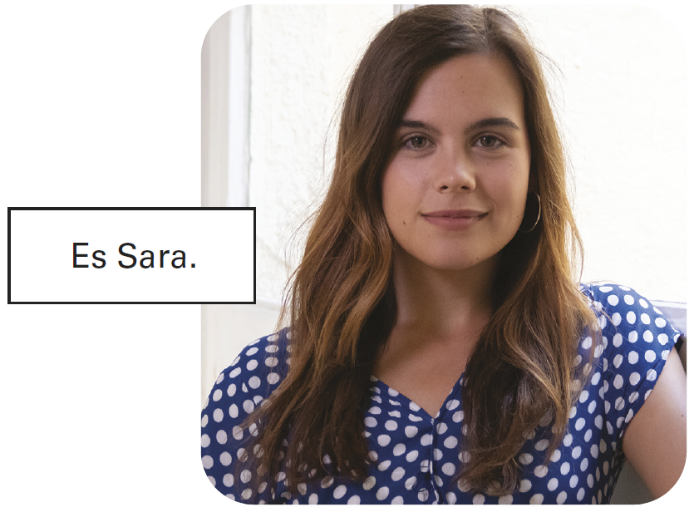
Present tense of ser
Uses of ser
Use ser to identify people and things.
— ¿Quién es él? Who is he? — Es Manuel Vásquez Quevedo. He’s Manuel Vásquez Quevedo. | — ¿Qué es? What is it? — Es un mapa de España. It’s a map of Spain.

Slide 9
Present tense of ser
Ser also expresses possession, with the preposition de. There is no Spanish equivalent of the English construction [noun] + ’s (Maru’s). In its place, Spanish uses [noun] + de + [owner].
— ¿De quién es? Whose is it? — Es el diario de Valentina. It’s Valentina's diary. | — ¿De quién son? Whose are they? — Son los lápices de la chica. They are the girl’s pencils.

Slide 10
Present tense of ser
When de is followed by the article el, the two combine to form the contraction del. De does not contract with la, las, or los.
— Es la computadora del conductor. It’s the driver’s computer. | — Son las maletas del chico. They are the boy’s suitcases.

Slide 11
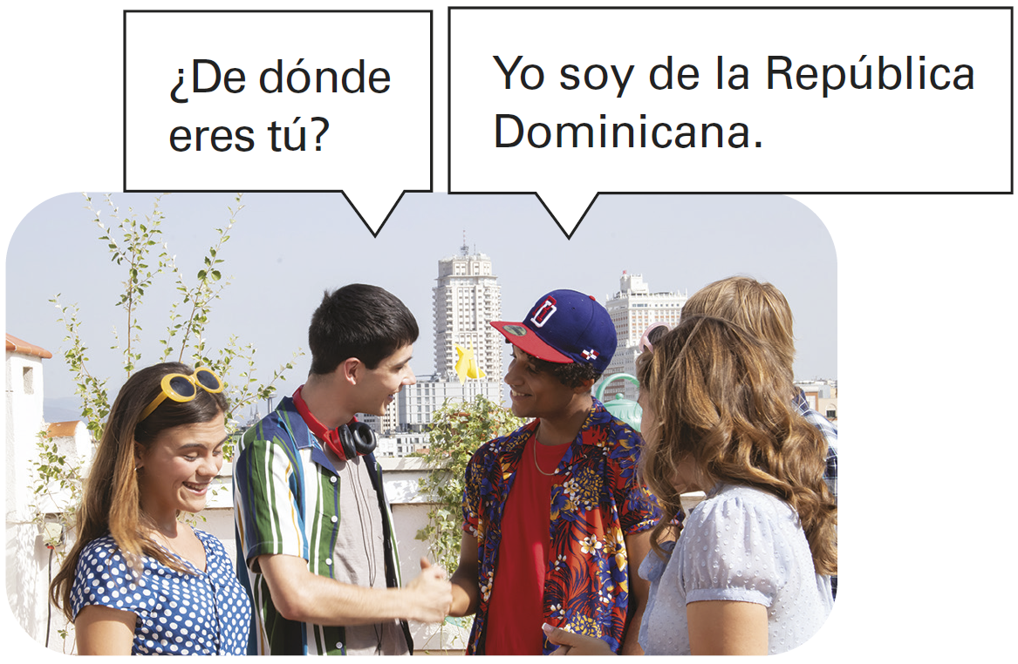
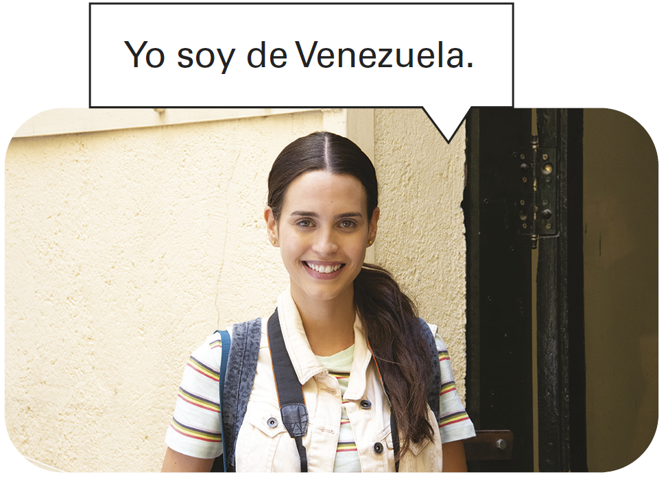
Present tense of ser
Ser also uses the preposition de to express origin.

Slide 12
Present tense of ser
—¿De dónde es Manuel? Where is Manuel from? — Es de España. He’s from Spain. | —¿De dónde es Olga Lucía? Where is Olga Lucía from? — Es de Venezuela. She’s from Venezuela.

Slide 13
Present tense of ser
Use ser to express profession or occupation.
Don Francisco es conductor. Don Francisco is a driver. | Yo soy estudiante. I am a student.

Slide 14
Present tense of ser
Unlike English, Spanish does not use the indefinite article (un, una) after ser when referring to professions, unless accompanied by an adjective or other description.
Marta es profesora. Marta is a teacher. | Marta es una profesora excelente. Marta is an excellent teacher.

Slide 15
Present tense of ser

Slide 16
Present tense of ser
Provide the correct subject pronouns and the present forms of ser. The first item has been done for you.
¡INTÉNTALO!
Gabriel _________ _________ Juan y yo _________ _________ Óscar y Flora _________ _________ Adriana _________ _________ | las turistas _________ _________ el chico _________ _________ los conductores _________ _________ los señores Ruiz _________ _________
él
es

