Slide 1
Numbers 0–30
Los números 0 a 30
0 cero 1 uno 2 dos 3 tres 4 cuatro 5 cinco 6 seis 7 siete 8 ocho 9 nueve 10 diez | 11 once 12 doce 13 trece 14 catorce 15 quince 16 dieciséis 17 diecisiete 18 dieciocho 19 diecinueve 20 veinte | 21 veintiuno 22 veintidós 23 veintitrés 24 veinticuatro 25 veinticinco 26 veintiséis 27 veintisiete 28 veintiocho 29 veintinueve 30 treinta

Slide 2
Numbers 0–30
The number uno (one) and numbers ending in –uno, such as veintiuno, have more than one form. Before masculine nouns, uno shortens to un. Before feminine nouns, uno changes to una.
un hombre | veintiún hombres | una mujer | veintiuna mujeres

Slide 3
Numbers 0–30
¡Atención! The forms uno and veintiuno are used when counting (uno, dos, tres... veinte, veintiuno, veintidós...). They are also used when the number follows a noun, even if the noun is feminine: la lección uno.

Slide 4
Numbers 0–30
To ask how many people or things there are, use cuántos before masculine nouns and cuántas before feminine nouns.

Slide 5
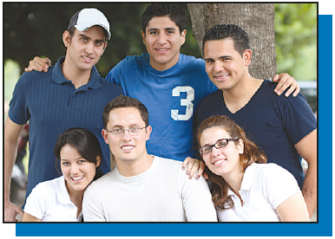
Numbers 0–30
The Spanish equivalent of both there is and there are is hay. Use ¿Hay...? to ask Is there...? or Are there...? Use no hay to express there is not or there are not.
— ¿Cuántos estudiantes hay? How many students are there? — Hay seis estudiantes en la foto. There are six students in the photo. | — ¿Hay chicos en la fotografía? Are there guys in the picture? — Hay tres chicas y no hay chicos. There are three girls, and there are no guys.

Slide 6
Numbers 0–30
¡INTÉNTALO!
Provide the Spanish words for these numbers.
1. 7 ________ 2. 16 ________ 3. 29 ________ 4. 1 ________ | 5. 0 ________ 6. 15 ________ 7. 21 ________ 8. 9 ________ | 9. 23 ________ 10. 11 ________ 11. 30 ________ 12. 4 ________ | 13. 12 ________ 14. 28 ________ 15. 14 ________ 16. 10 ________

