Slide 1
Nouns and articles
Spanish nouns
A noun is a word used to identify people, animals, places, things, or ideas. Unlike English, all Spanish nouns, even those that refer to non-living things, have gender; that is, they are considered either masculine or feminine. As in English, nouns in Spanish also have number, meaning that they are either singular or plural.
ANTE TODO

Slide 2
Nouns and articles
Nouns that refer to living things
Masculine nouns
Feminine nouns
el hombre | the man |  | la mujer | the woman
ending in –o
ending in –a
el chico el pasajero | the boy the (male) passenger |  | la chica la pasajera | the girl the (female) passenger
ending in –or
ending in –ora
el conductor el profesor | the (male) driver the (male) teacher |  | la conductora la profesora | the (female) driver the (female) teacher
ending in –ista
ending in –ista
el turista | the (male) tourist |  | la turista | the (female) tourist

Slide 3
Nouns and articles
Generally, nouns that refer to males, like el hombre, are masculine, while nouns that refer to females, like la mujer, are feminine.

Slide 4
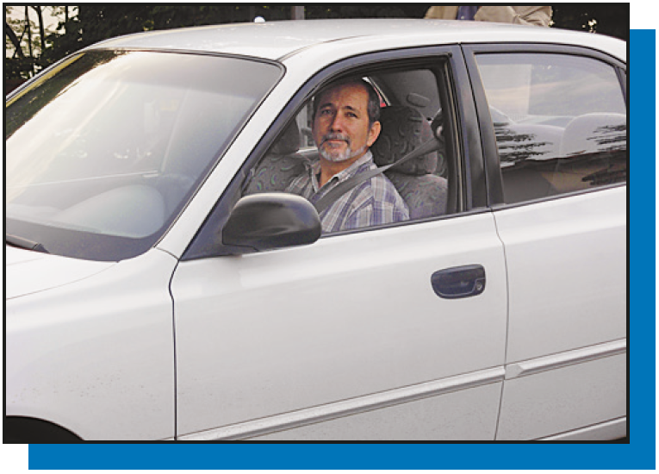
Nouns and articles
Many nouns that refer to male nouns end in –o or –or. Their corresponding feminine forms end in –a and –ora, respectively.
el conductor
la profesora

Slide 5
Nouns and articles
The masculine and feminine forms of nouns that end in –ista, like turista, are the same, so gender is indicated by the article el (masculine) or la (feminine). Some other nouns have identical masculine and feminine forms.
el joven the youth; the young man el estudiante the (male) student | la joven the youth; the young woman la estudiante the (female) student

Slide 6
Nouns and articles
Nouns that refer to non-living things
Masculine nouns
Feminine nouns
ending in –o
ending in –a
el cuaderno el diario el diccionario el número el video | the notebook the diary the dictionary the number the video |  | la cosa la escuela la computadora la maleta la palabra | the thing the school the computer the suitcase the word
ending in –ma
ending in –ción
el problema el programa | the problem the program |  | la lección la conversación | the lesson the conversation
ending in –s
ending in –dad
el autobús el país | the bus the country |  | la nacionalidad la comunidad | the nationality the community

Slide 7
Nouns and articles
As shown above, certain noun endings are strongly associated with a specific gender, so you can use them to determine if a noun is masculine or feminine.

Slide 8
Nouns and articles
Because the gender of nouns that refer to non-living things cannot be determined by foolproof rules, you should memorize the gender of each noun you learn. It is helpful to learn each noun with its corresponding article, el for masculine and la for feminine.

Slide 9
Nouns and articles
Another reason to memorize the gender of every noun is that there are common exceptions to the rules of gender. For example, el mapa (map) and el día (day) end in –a, but are masculine. La mano (hand) ends in –o, but is feminine.

Slide 10
Nouns and articles
Plural of nouns
To form the plural add –s to nouns that end in a vowel. For nouns that end in a consonant add –es. For nouns that end in z change the z to c, then add –es.
el chico el diario el problema | los chicos los diarios los problemas | la nacionalidad el país el lápiz (pencil) | las nacionalidades los países los lápices

Slide 11
Nouns and articles
In general, when a singular noun has an accent mark on the last syllable, the accent is dropped from the plural form.
la lección | las lecciones | el autobús | los autobuses

Slide 12
Nouns and articles
Use the masculine plural form to refer to a group that includes both males and females.
1 pasajero + 2 pasajeras = 3 pasajeros | 2 chicos + 2 chicas = 4 chicos

Slide 13
Nouns and articles
Spanish articles
As you know, English often uses definite articles (the) and indefinite articles (a, an) before nouns. Spanish also has definite and indefinite articles. Unlike English, Spanish articles vary in form because they agree in gender and number with the nouns they modify.
ANTE TODO

Slide 14
Nouns and articles
Definite articles
ANTE TODO
Spanish has four forms that are equivalent to the English definite article the. Use definite articles to refer to specific nouns.
Masculine
Feminine
SINGULAR
PLURAL
SINGULAR
PLURAL
el diccionario the dictionary | los diccionarios the dictionaries | la computadora the computer | las computadoras the computers

Slide 15
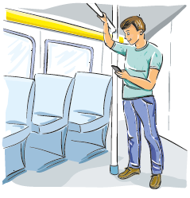
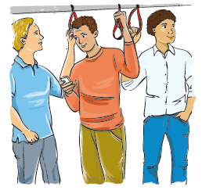
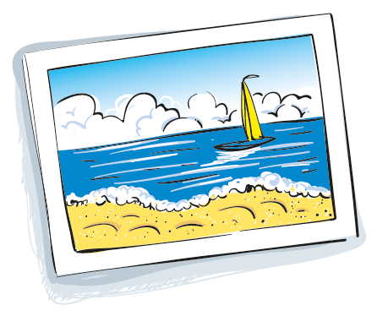
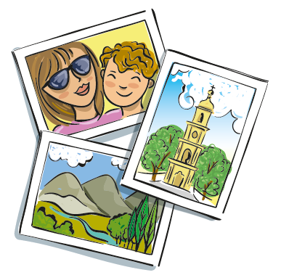
Nouns and articles
Indefinite articles
Spanish has four forms that are equivalent to the English indefinite article, which according to context may mean a, an, or some. Use indefinite articles to refer to unspecified numbers of persons or things.
Masculine
Feminine
SINGULAR
PLURAL
SINGULAR
PLURAL
un pasajero a (one) passenger | unos pasajeros some passengers | una fotografía a (one) photograph | unas fotografías some photographs

Slide 16
Nouns and articles
Provide a definite article for each noun in the first column and an indefinite article for each noun in the second column.
¡INTÉNTALO!
¿el, la, los o las? | ¿un, una, unos o unas?
1. ___________ chica 2. ___________ chico 3. ___________ maleta 4. ___________ cuadernos 5. ___________ lápiz 6. ___________ mujeres | 1. ___________ autobús 2. ___________ escuelas 3. ___________ computadora 4. ___________ hombres 5. ___________ señora 6. ___________ lápices
la
un

