Slide 1
Descriptive adjectives
Adjectives are words that describe people, places, and things. In Spanish, descriptive adjectives are used with the verb ser to point out characteristics such as nationality, size, color, shape, personality, and appearance.

Slide 2
Descriptive adjectives
Forms and agreement of adjectives
COMPARE & CONTRAST
In English, the forms of descriptive adjectives do not change to reflect the gender (masculine/feminine) and number (singular/plural) of the noun or pronoun they describe.
Juan is nice. | Elena is nice. | They are nice.
In Spanish, the forms of descriptive adjectives agree in gender and/or number with the nouns or pronouns they describe.
Juan es simpático. | Elena es simpática. | Ellos son simpáticos.

Slide 3
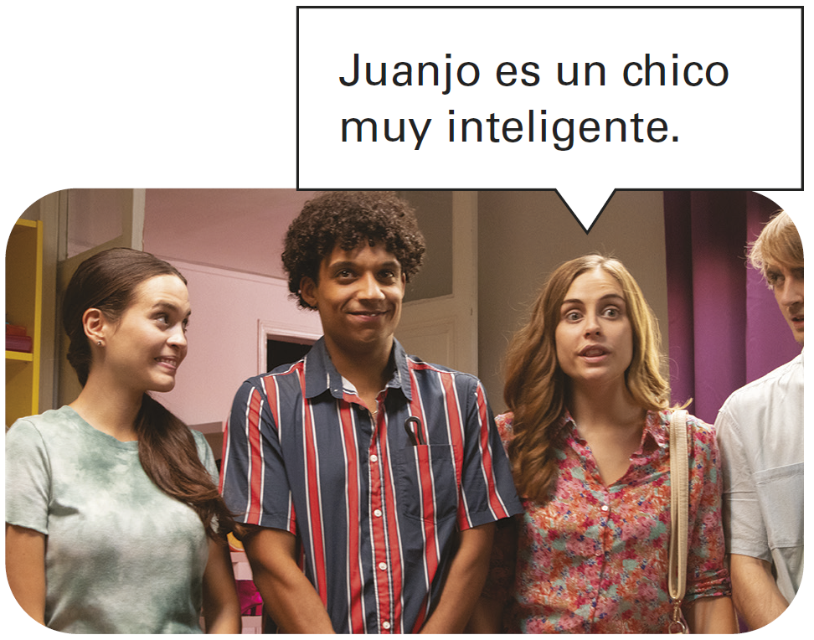
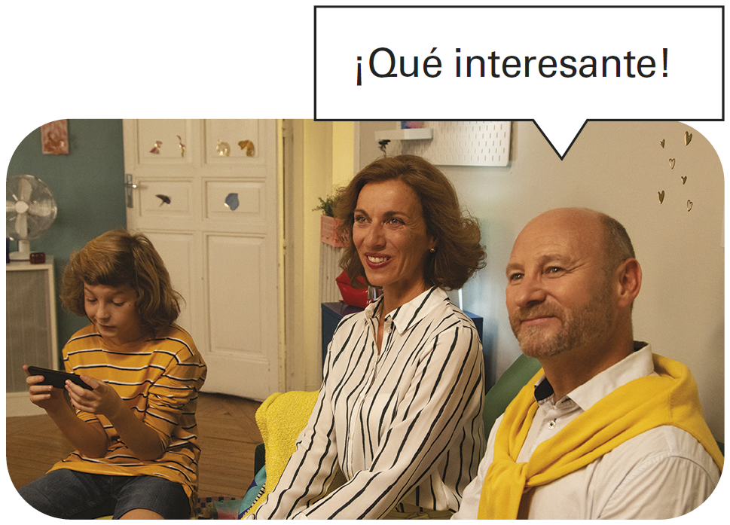
Descriptive adjectives
Adjectives that end in -o have four different forms. The feminine singular is formed by changing the -o to -a. The plural is formed by adding -s to the singular forms.
Masculine
Feminine
SINGULAR
PLURAL
SINGULAR
PLURAL
el muchacho alto | los muchachos altos | la muchacha alta | las muchachas altas

Slide 4
Descriptive adjectives
Adjectives that end in -e or a consonant have the same masculine and feminine forms.
Masculine
Feminine
SINGULAR
PLURAL
SINGULAR
PLURAL
el chico inteligente el examen difícil | los chicos inteligentes los exámenes difíciles | la chica inteligente la clase difícil | las chicas inteligentes las clases difíciles

Slide 5
Descriptive adjectives
Adjectives that end in -or, like adjectives that end in -o, have four different forms.
Masculine
Feminine
SINGULAR
PLURAL
SINGULAR
PLURAL
el hombre trabajador | los hombres trabajadores |  | la mujer trabajadora | las mujeres trabajadoras

Slide 6
Descriptive adjectives
Adjectives that refer to nouns of different genders use the masculine plural form.
Manuel es alto. | Lola es alta. | Manuel y Lola son altos.
Common adjectives
alto/a antipático/a bajo/a bonito/a bueno/a delgado/a difícil fácil feo/a | tall unpleasant short (in height) pretty good thin; slender hard; difficult easy ugly | gordo/a grande guapo/a importante inteligente interesante joven (jóvenes) malo/a mismo/a | fat big; large good-looking important intelligent interesting young bad same | moreno/a mucho/a pelirrojo/a pequeño/a rubio/a simpático/a tonto/a trabajador(a) viejo/a | brunet(te) much; many; a lot of red-haired small blond(e) nice; likeable silly; foolish hard-working old

Slide 7
Descriptive adjectives
Colors
amarillo/a azul blanco/a | yellow blue white | negro/a rojo/a verde | black red green

Slide 8
Descriptive adjectives
Some adjectives of nationality
In Spanish, country names are capitalized, but adjectives of nationality are not.
Some adjectives of nationality
alemán, alemana argentino/a canadiense chino/a costarricense cubano/a ecuatoriano/a español(a) estadounidense | German Argentine Canadian Chinese Costa Rican Cuban Ecuadorian Spanish from the U.S. | francés, francesa inglés, inglesa italiano/a japonés, japonesa mexicano/a norteamericano/a puertorriqueño/a ruso/a | French English Italian Japanese Mexican (North) American Puerto Rican Russian

Slide 9
Descriptive adjectives
Adjectives of nationality that end in a consonant form the feminine by adding -a.
japonés | japonesa | español | española
Adjectives of color and nationality are formed like other descriptive adjectives.
Masculine
Feminine
SINGULAR
PLURAL
SINGULAR
PLURAL
argentino azul verde | argentinos azules verdes | argentina azul verde | argentinas azules verdes

Slide 10
Descriptive adjectives
¡Atención! Note that adjectives with an accent on the last syllable drop the accent in the feminine and plural forms.
Inglés alemán | Inglesa alemanes

Slide 11
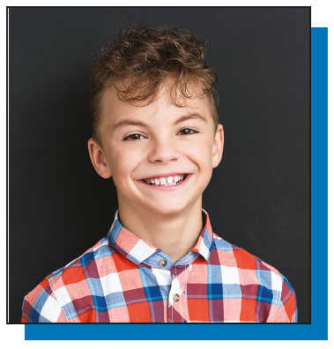
Descriptive adjectives
Position of adjectives
Descriptive adjectives and adjectives of nationality generally follow the nouns they modify.
El niño rubio es de España. The blond boy is from Spain. | La mujer española habla inglés. The Spanish woman speaks English.

Slide 12
Descriptive adjectives
Unlike descriptive adjectives, adjectives of quantity precede the modified noun.
Hay muchos libros en la biblioteca. There are many books in the library. | Hablo con dos turistas puertorriqueños. I am talking with two Puerto Rican tourists.

Slide 13
Descriptive adjectives
Bueno/a and malo/a can appear before or after a noun. When placed before a masculine singular noun, the forms are shortened: Bueno buen; malo mal.
Joaquín es un buen amigo. Joaquín es un amigo bueno. | Joaquín is a good friend.
Hoy es un mal día. Hoy es un día malo. | Today is a bad day.

Slide 14
Descriptive adjectives
When grande appears before a singular noun, it is shortened to gran, and the meaning of the word changes: gran = great and grande = big, large.
Don Francisco es un gran hombre. Don Francisco is a great man. | La familia de Inés es grande. Inés’ family is large.

Slide 15
Descriptive adjectives
¡INTÉNTALO!
Provide the appropriate forms of the adjectives.
simpático | alemán
1. Mi hermano es simpático ___________. 2. La profesora Martínez es___________. 3. Rosa y Teresa son ___________. 4. Nosotros somos ___________. | 1. Hans es alemán ___________. 2. Mis primas son ___________. 3. Marcus y yo somos ___________. 4. Mi tía es ___________.
simpático
alemán

Slide 16
Descriptive adjectives
¡INTÉNTALO!
Provide the appropriate forms of the adjectives. (cont.)
azul | guapo
1. La calculadora es ___________. 2. El papel es ___________. 3. Las maletas son ___________. 4. Los libros son ___________. | 1. Su esposo es guapo ___________. 2. Mis sobrinas son ___________. 3. Los padres de ella son ___________. 4. Marta es ___________.
azul
guapo

