Slide 1
Si clauses
Imagina 9-3

Slide 2
Si clauses
Si (if) clauses express a condition or event upon which another condition or event depends.
Sentences with si clauses are often hypothetical statements.
They contain a subordinate clause (si clause) and a main clause (result clause).
The si clause may be the first or second clause in a sentence. Note that a comma is used only when the si clause comes first.

Slide 3
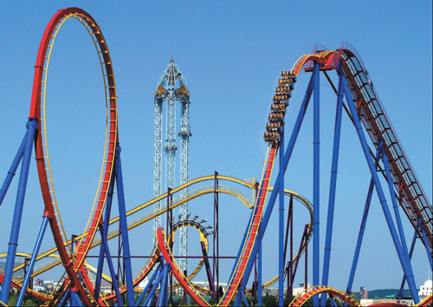
Por ejemplo…
Si tienes tiempo, ven con nosotros al parque de atracciones.
If you have time, come with us to the amusement park.

Slide 4
Por ejemplo…
Iré con ustedes si no tengo que trabajar.
I’ll go with you if I don’t have to work.

Slide 5
Si (if) does not carry a written accent. However, sí (yes) does carry a written accent.
Por ejemplo:
Si puedes, ven. Come if you can.
Sí, puedo. Yes, I can.
¡ATENCIÓN!

Slide 6
Hypothetical statements about possible events
In hypothetical statements about conditions or events that are possible or likely to occur, the si clause uses the present indicative.
In this case, the main clause may use:
the present indicative
the future indicative
ir a + [infinitive]
a command

Slide 7
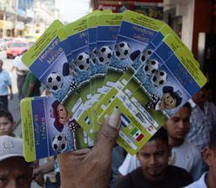
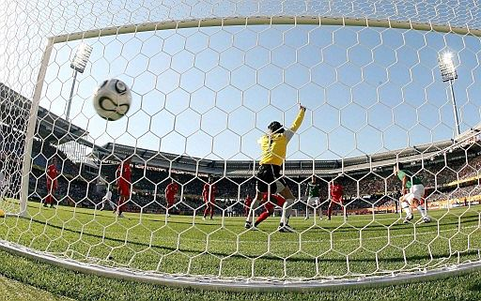
Hypothetical statements about possible events - ejemplos
Si clause: Present indicative
Main clause
Si usted no juega a la lotería, If you don’t play the lottery, | PRESENT TENSE | no puede ganar. you can’t win.
Si Gisela está dispuesta a hacer cola, If Gisela is willing to wait in line, | FUTURE TENSE | conseguirá entradas, seguro. she’ll definitely get tickets.
Si marcan un solo gol más, If they score just one more goal, | IR A + [INFINITIVE] | van a ganar el partido. they are going to win the game.
Si sales temprano del trabajo, If you finish work early, | COMMAND | vámonos a un concierto. let’s go to a concert.

Slide 8
Hypothetical statements about improbable situations
In hypothetical statements about current conditions or events that are improbable or contrary-to-fact, the si clause uses the past subjunctive. The main clause uses the conditional.
SiPS, would
(Si + Past Subjunctive, conditional (=would)
A contrary-to-fact situation is one that is possible, but will probably not happen and/or has not occurred.
¡ATENCIÓN!

Slide 9
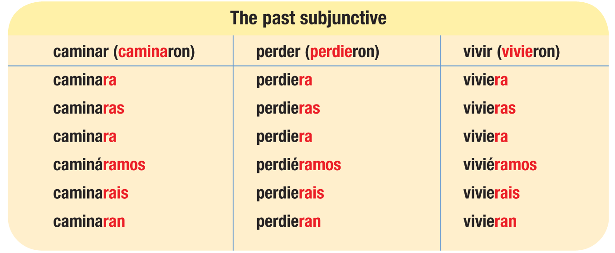
Repaso: Las formas del imperfecto del subjuntivo
El imperfecto del subjuntivo of all verbs is formed by dropping the –ron ending from the ustedes/ellos/ellas form of the preterite and adding the past subjunctive endings.
Note that all nosotros/as forms have a written accent.

Slide 10
Repaso: Los irregulares
Verbs that have stem changes or irregularities in the ustedes/ellos/ellas form of the preterite have those same irregularities in all forms of the past subjunctive.
infinitive preterite form past subjunctive forms
pedir pidieron pidiera, pidieras, pidiera, pidiéramos, pidierais, pidieran
sentir sintieron sintiera, sintieras, sintiera, sintiéramos, sintierais, sintieran
dormir durmieron durmiera, durmieras, durmiera, durmiéramos, durmierais, durmieran
influir influyeron influyera, influyeras, influyera, influyéramos, influyerais, influyeran
saber supieron supiera, supieras, supiera, supiéramos, supierais, supieran
ir/ser fueron fuera, fueras, fuera, fuéramos, fuerais, fueran

Slide 11
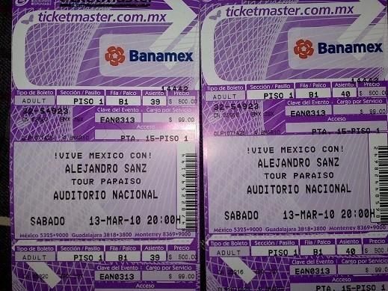
Por ejemplo…
Si clause: Past subjunctive
Main clause: Conditional
Si tuviéramos boletos, If we had tickets, | iríamos al concierto. we would go to the concert.
Si no estuviera tan cansada, If I weren’t so tired, | saldría a cenar contigo. I’d go out to dinner with you.

Slide 12
Habitual conditions and actions in the past
In statements that express habitual past actions that are not contrary-to-fact, both the si clause and the main clause use the imperfect.

Slide 13
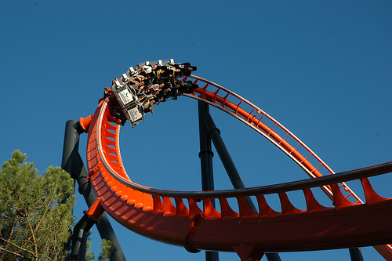
Habitual conditions and actions in the past- ejemplos
Si clause: Imperfect
Main clause: Imperfect
Si Milena tenía tiempo libre, If Milena had free time, | siempre iba a la playa. she would always go to the beach.
De niño, si iba a la feria, As a child, if I'd go to the fair, | siempre me montaba en la montaña rusa. I would always ride the roller coaster.

Slide 14
Hypothetical statements about the past
In hypothetical statements about contrary-to-fact situations in the past, the si clause describes what would have happened if another event or condition had occurred. The si clause uses the past perfect subjunctive. The main clause uses the conditional perfect.
Si clause: Past perfect subjunctive
Main clause: Conditional perfect
Si no me hubiera lastimado el pie, If I hadn’t injured my foot, | habría ganado la carrera. I would have won the race.
Si me hubieras llamado antes, If you had called me sooner, | habríamos podido reunirnos. we would have been able to get together.

