Slide 1
Los usos del infinitivo
IMAGINA LECCIóN 8.3

Slide 2
El infinitivo
¿Qué es el infinitivo?
An infinitive is the unconjugated form of a verb and ends in –ar, –er, or –ir.
¡ATENCIÓN!

Slide 3
El infinitivo
The infinitive (el infinitivo) is commonly used after other conjugated verbs, especially when there is no change of subject.
Deber, decidir, desear, necesitar, pensar, poder, preferir, querer, and saber are all frequently followed by infinitives.

Slide 4
Ejemplos
Mis primos han decidido comprarle una computadora a mi abuela.
My cousins have decided to buy a computer for my grandmother.
¡Qué buena idea! No sabía que ella quería tener una.
What a good idea! I didn’t know that she wanted to have one.

Slide 5
El infinitivo
Verbs of perception, such as escuchar, mirar, oír, sentir, and ver, are followed by the infinitive even if there is a change of subject.
The use of an object pronoun with the conjugated verb distinguishes the two subjects and eliminates the need for a subordinate clause.

Slide 6
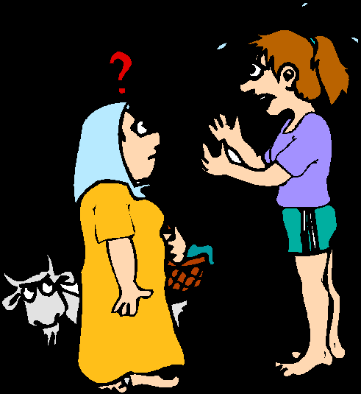
Ejemplos
Te oigo hablar, ¡pero no entiendo nada!
I hear you speaking, but I don’t understand anything!
Si la ven salir, avísenme enseguida.
If you see her leave, let me know immediately.

Slide 7
El infinitivo
Many verbs of influence, such as dejar, hacer, mandar, permitir, and prohibir, may also be followed by the infinitive.
The object pronoun makes a subordinate clause unnecessary.

Slide 8
Ejemplos
La profesora nos hizo leer artículos sobre el ADN.
The teacher made us read articles about DNA.
El comité me ha dejado continuar con los experimentos.
The committee has allowed me to continue with the experiments.

Slide 9
El infinitivo
The infinitive may be used with impersonal expressions, such as es bueno, es fácil, and es importante.
It is required after hay que and tener que.

Slide 10
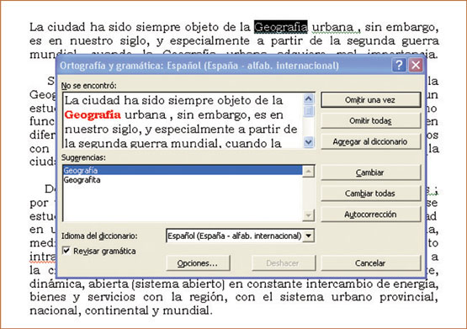
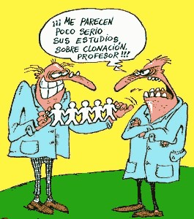
Ejemplos
Es importante utilizar el corrector ortográfico.
It is important to use the spell-checker.
¿Es ético clonar a un ser humano?
Is it ethical to clone a human being?

Slide 11
El infinitivo
In Spanish, unlike in English, the gerund form of a verb (talking, working, etc.) may not be used as a noun or in giving instructions.
The infinitive form, with or without the definite article el, is used instead.

Slide 12
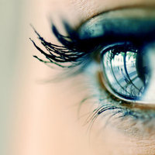
Ejemplos
Ver es creer.
Seeing is believing.
Descargar es fácil.
Downloading is easy.
El arte del mirar
The art of seeing

Slide 13
El infinitivo
You will often see infinitives where English uses commands on signs and written instructions.
Empujar
No fumar
Seguir con cuidado

Slide 14
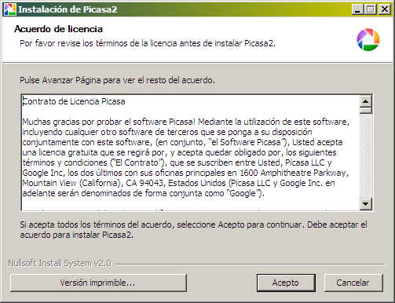
El infinitivo
After prepositions, the infinitive is used.
Por ejemplo:
El Dr. Pérez necesitó veinte años para demostrar sus teorías.
Dr. Pérez needed twenty years in order to prove his theories.
Él no podrá abrir el documento
sin instalar el programa.
He won’t be able to open the document
without installing the program.

Slide 15
El infinitivo
Many Spanish verbs follow the pattern of [conjugated verb] + [preposition] + [infinitive]. The prepositions for this pattern are de, a, or en.

Slide 16
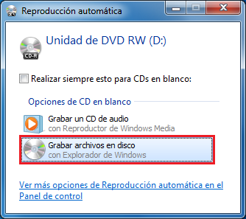
Ejemplos
Me enseñó a grabar un CD.
She taught me how to burn a CD.
Trato de estudiar todos los días.
I try to study every day.
Su computadora tarda en encenderse.
His computer takes a while to start.
Quedamos en hacerlo.
We agreed to do it.

Slide 17
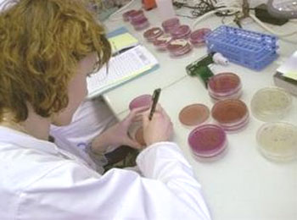
El infinitivo
Deber + de + [infinitive] suggests probability.
Por ejemplo:
La bióloga debe de anunciar sus resultados hoy.
The biologist probably announces her results today.
But…
La bióloga debe anunciar sus
resultados hoy.
The biologist has to announce her results today.

