Slide 1
El pluscuamperfecto
Imagina Lección 8-1

Slide 2
El pluscuamperfecto
To form the past perfect tense (el pluscuamperfecto):
imperfect of haber + past participle
Past participles are formed by dropping the –ar ending of an infinitive and adding –ado or dropping the –er/-ir ending and adding –ido. As with other perfect tenses, the past participle does not change form (no plural forms or changing gender).

Slide 3
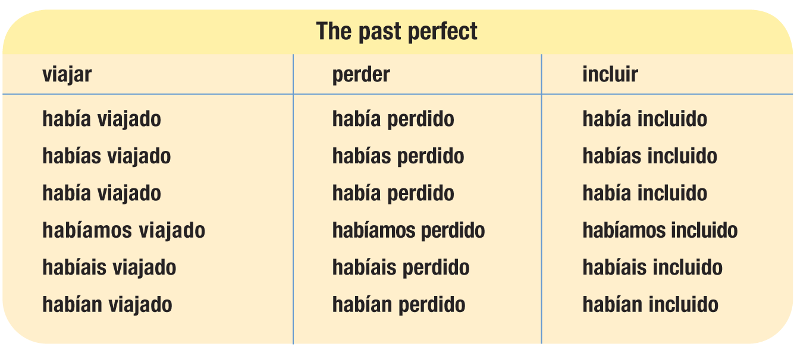
El pluscuamperfecto

Slide 4
Not exactly irregular but…
-er and –ir verbs whose stems end in a vowel have past participles ending in –ído
caer → caído creer → creído
leer → leído oír → oído
reír → reído traer → traído

Slide 5
Los irregulares
The following verbs have irregular past participles ending in –to:
abrir → abierto cubrir → cubierto
escribir → escrito poner → puesto
morir → muerto ver → visto
romper → roto volver → vuelto

Slide 6
Más irregulares
These verbs have irregular past participles ending in –cho:
decir → dicho
hacer → hecho

Slide 7
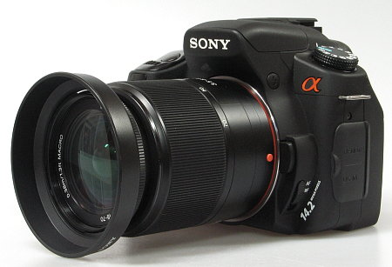
In Spanish, as in English, the past perfect expresses what someone had done or what had occurred before another action or condition in the past.
Decidí comprar una cámara digital nueva porque la vieja se me había roto varias veces. | Cuando por fin les dieron la patente, otros ingenieros ya habían inventado una tecnología mejor.
I decided to buy a new digital camera because the old one had broken several times. | When they were finally given the patent, other engineers had already invented a better technology.

Slide 8
The following words are often used with the past perfect to indicate that one past action occurred before another.
antes (before)
aún (still)
nunca (never)
todavía no (not yet)
ya (already)
Note that these adverbs, as well as pronouns and the word no, may not come between haber and the past participle.

Slide 9
Note that in English, an adverb may come between the verb to have and a past participle. This is not the case in Spanish.
Los humanos ya habían llegado a la Luna cuando mandaron una nave a Júpiter.
Humans had already reached the Moon when they sent a spacecraft to Jupiter.
¡ATENCIÓN!

Slide 10
Ejemplos
Cuando apagué la computadora, aún no había guardado el documento. ¡Lo perdí!
When I shut off the computer, I hadn’t yet saved the document. I lost it!

Slide 11
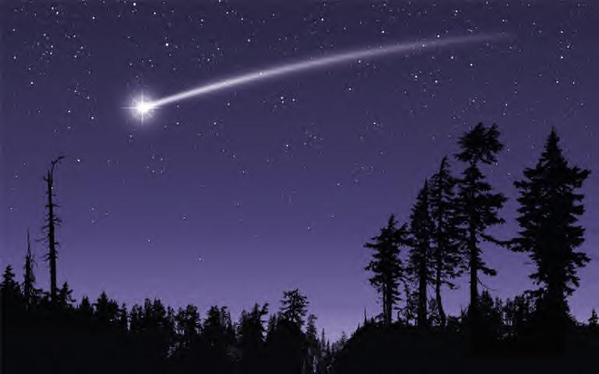
Ejemplos
Nunca había visto una estrella fugaz tan luminosa antes.
I had never seen such a bright shooting star before.

Slide 12
Ejemplos
Ya me había explicado la teoría, pero no la entendí hasta que vi el experimento.
He had already explained the theory to me, but I didn’t understand it until I saw the experiment.

Slide 13
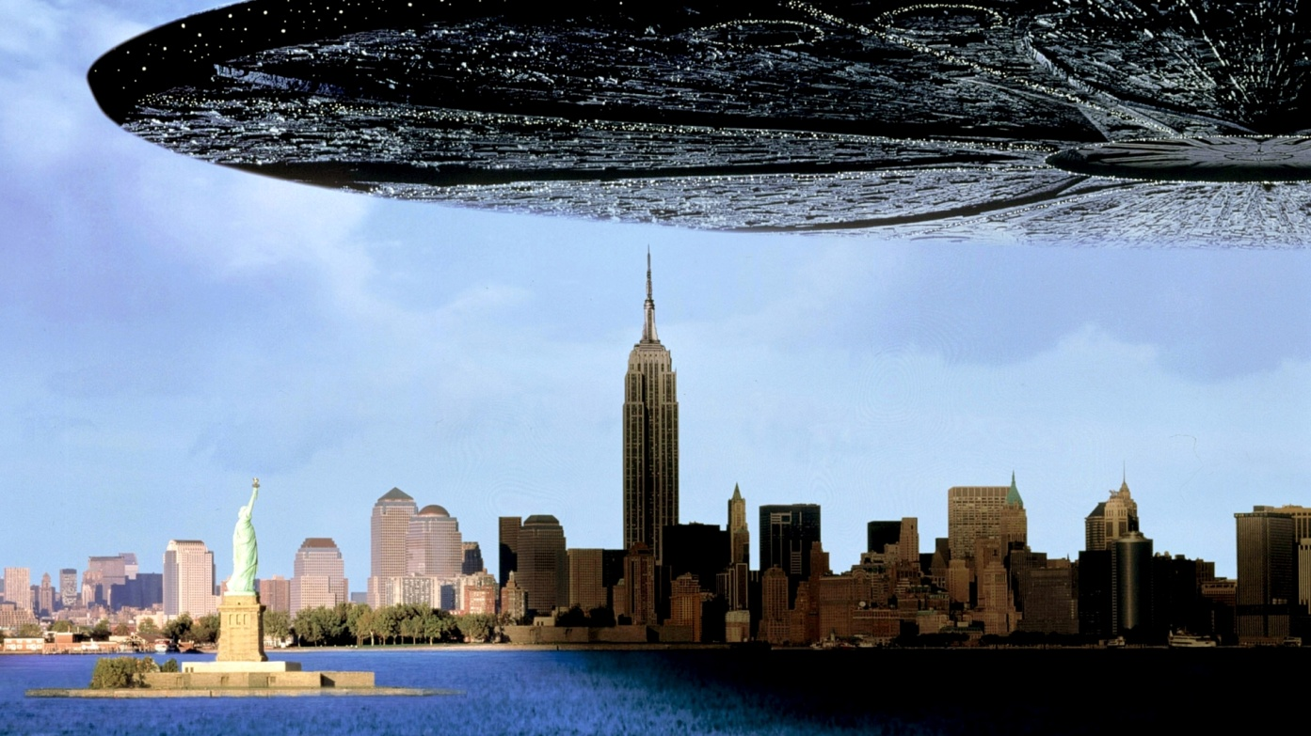
Ejemplos
Los ovnis todavía no habían aterrizado, pero los terrícolas ya estaban corriendo.
The UFOs hadn’t yet landed, but the Earthlings were already running.

