Slide 1
El pretérito perfecto del subjuntivo
Imagina Lección 7.2
pga. 252

Slide 2
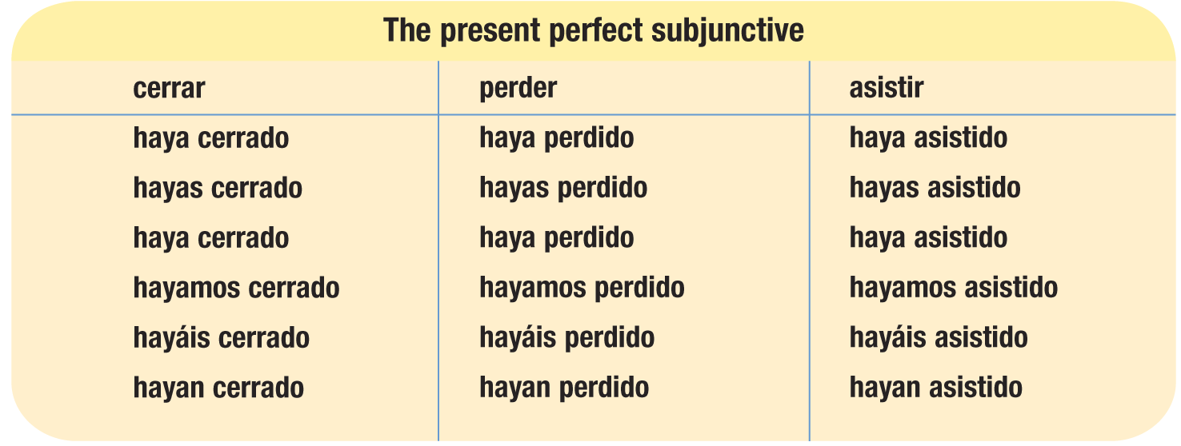
El pretérito perfecto del subjuntivo
The present perfect subjunctive (el pretérito perfecto del subjuntivo) is formed with the present subjunctive of haber and a past participle.

Slide 3
El pretérito perfecto del subjuntivo
The present perfect subjunctive is used to refer to recently completed actions or past actions that still bear relevance in the present.
It is used mainly in the subordinate clause of a sentence whose main clause expresses will, emotion, doubt, or uncertainty.

Slide 4
¿indicativo o subjuntivo?
Indicativo = hechos
Luis ha dejado de usar su tarjeta de crédito.
Subjuntivo = creencias, pensamientos
No creo que Luis haya dejado de usar su tarjeta de crédito.

Slide 5
Tipos de subjuntivo
Note the different contexts in which you must use the subjunctive tenses you have learned so far.
In a multiple-clause sentence, the choice of tense for the verb in the subjunctive depends on when the action takes place in each clause. The present perfect subjunctive is used primarily when the action of the main clause is in the present tense, but the action in the subordinate clause is in the past.
¡ATENCIÓN!

Slide 6
El presente del subjuntivo
Las empresas multinacionales buscan empleados que hablen varios idiomas.
Multinational companies are looking for employees who speak several languages.

Slide 7
El pretérito perfecto del subjuntivo
Prefieren contratar a los que hayan viajado al extranjero.
They prefer to hire those who have traveled abroad.

Slide 8
El imperfecto del subjuntivo
Antes, casi todas insistían en que los solicitantes tuvieran cinco años de experiencia.
In the past, almost all of them insisted that applicants have five years of experience.

