Slide 1
In Spanish, several verbs have irregular yo forms in the present tense. You have already seen three verbs with the -go ending in the yo form: decir  digo, tener  tengo, and venir  vengo.

Slide 2
Here are some common expressions with decir.

Slide 3
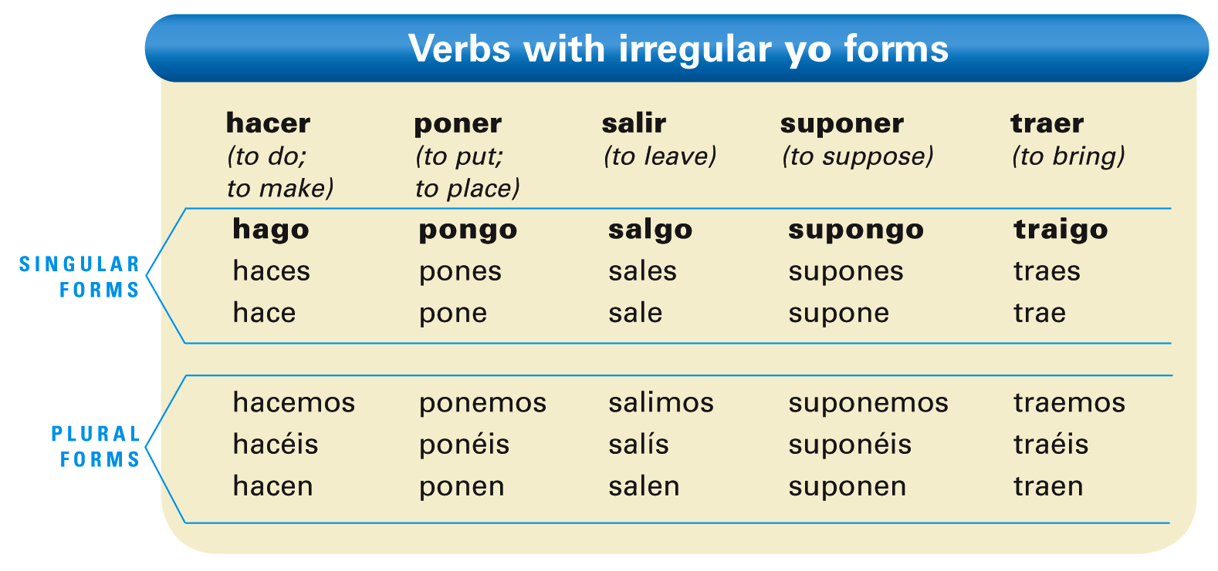
The verb hacer is often used to ask questions about what someone does. Note that when answering, hacer is frequently replaced with another, more specific action verb.

Slide 5
Poner can also mean to turn on a household appliance.

Slide 6
Salir de is used to indicate that someone is leaving a particular place.

Slide 7
Salir para is used to indicate someone’s destination.

Slide 8
Salir con means to leave with someone or something, or to date someone.

Slide 9
The verbs ver and oír
The verb ver (to see) has an irregular yo form. The other forms of ver are regular.

Slide 10
The verb oír (to hear) has an irregular yo form and the spelling change i:y in the tú, usted, él, ella, ustedes, ellos, and ellas forms. The nosotros/as and vosotros/as forms have an accent mark.

Slide 11
While most commonly translated as to hear, oír is also used in contexts where English would use to listen.

Slide 12
Provide the appropriate forms of these verbs. The first item has been done for you.
salir ver poner hacer oír traer suponer | Isabel _____. Yo _____. Rita y yo _____. Yo _____. Él _____. Ellas _____. Yo _____. | Nosotros _____. Uds. _____. Yo _____. Tú _____. Nosotros _____. Yo _____. Mi amigo _____. | Yo _____. Tú _____. Los niños _____. Ud. _____. Yo _____. Tú _____. Nosotras _____.
sale

