Slide 1
You’ve already seen that many verbs in Spanish change their stem vowel when conjugated. There is a third kind of stem-vowel change in some verbs, such as pedir (to ask for; to request). In these verbs, the stressed vowel in the stem changes from e to i, as shown in the diagram.

Slide 2
As with other stem-changing verbs you have learned, there is no stem change in the nosotros/as or vosotros/as forms in the present tense.

Slide 3
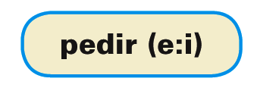
To help you identify verbs with the e:i stem change, they will appear as follows throughout the text:

Slide 4
These are the most common e:i stem-changing verbs:

Slide 5
¡Atención! The verb decir is irregular in its yo form: yo digo.

Slide 6
The yo forms of seguir and conseguir have a spelling change in addition to the stem change e:i.

Slide 7
Provide the correct forms of the verbs.
Arturo y Eva _______. Yo _____. Nosotros _____. Julia _____. Sofía y yo _____. | Yo _______. Él _____. Tú _____. Usted _____. Ellas _____. | Yo _______. Nosotros _____. Tú _____. Los chicos _____. Usted _____.
repetir (e:i)
decir (e:i)
seguir (e: i)
repiten
digo
sigo

