Slide 1
Stem-changing verbs: e:ie, o:ue
Stem-changing verbs deviate from the normal pattern of regular verbs. Note the spelling changes to the stem in the conjugations below.
INFINITIVE
VERB STEM
STEM CHANGE
CONJUGATED FORM
empezar
volver
empez-
volv-
empiez-
vuelv-
empiezo
vuelvo

Slide 2
Stem-changing verbs: e:ie, o:ue
In many verbs, such as empezar (to begin), the stem vowel changes from e to ie. Note that the nosotros/as and vosotros/as forms don’t have a stem change.
The verb empezar (e:ie) (to begin)
Singular forms
Plural forms
yo tú Ud./él/ella | empiezo empiezas empieza
nosotros/as vosotros/as Uds./ellos/ellas | empezamos empezáis empiezan

Slide 3
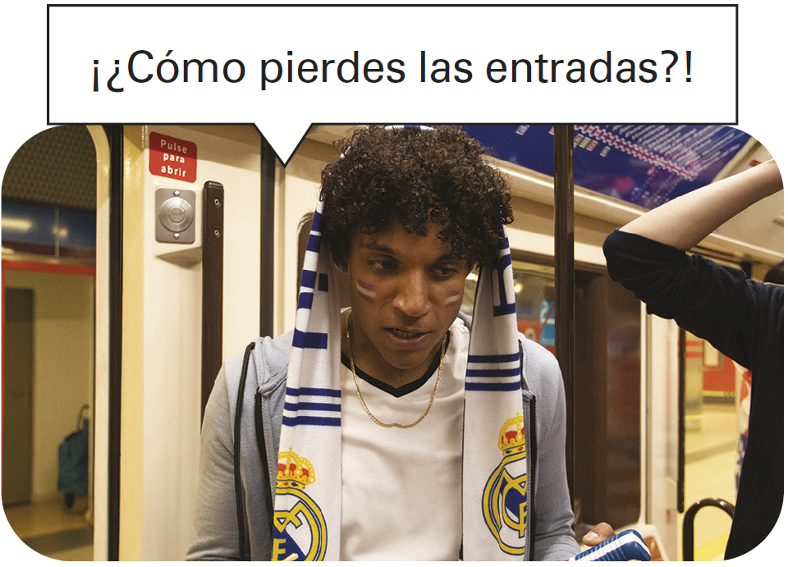
Stem-changing verbs: e:ie, o:ue

Slide 4
Stem-changing verbs: e:ie, o:ue
In many other verbs, such as volver (to return), the stem vowel changes from o to ue. The nosotros/as and vosotros/as forms have no stem change.
The verb volver (o:ue) (to return)
Singular forms
Plural forms
yo tú Ud./él/ella | vuelvo vuelves vuelve
nosotros/as vosotros/as Uds./ellos/ellas | volvemos volvéis vuelven

Slide 5
Stem-changing verbs: e:ie, o:ue
To help you identify stem-changing verbs, they will appear as follows throughout the text:
empezar (e:ie), volver (o:ue)

Slide 6
Stem-changing verbs: e:ie, o:ue
Common stem-changing verbs
e:ie
o:ue
cerrar comenzar (a + inf.) empezar (a + inf.) entender pensar perder preferir (+ inf.) querer (+ inf.) | to close to begin to begin to understand to think to lose; to miss to prefer to want; to love
almorzar contar dormir encontrar mostrar poder (+ inf.) recordar volver | to have lunch to count; to tell to sleep to find to show to be able to; can to remember to return

Slide 7
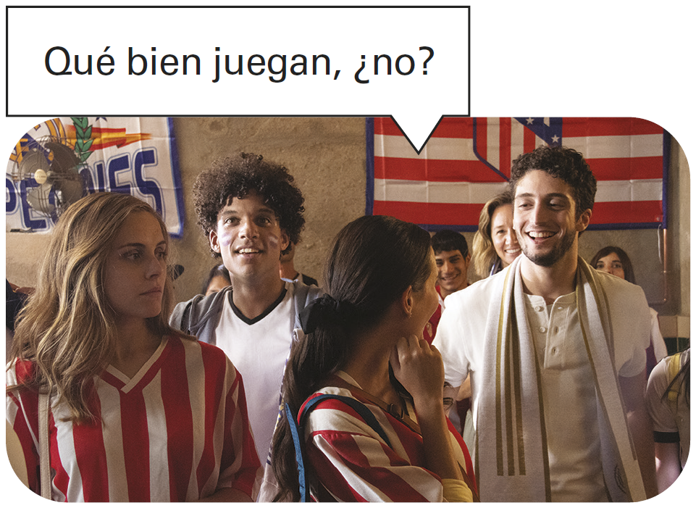
Stem-changing verbs: e:ie, o:ue
Jugar (to play a sport or game), is the only Spanish verb that has a u:ue stem change. Jugar is followed by a + [definite article] when the name of a sport or game is mentioned.

Slide 8
Stem-changing verbs: e:ie, o:ue
Comenzar and empezar require the preposition a when they are followed by an infinitive.
Comienzan a jugar a las siete. They begin playing at seven. | Ana empieza a escribir una postal. Ana is starting to write a postcard.

Slide 9
Stem-changing verbs: e:ie, o:ue
Pensar + [infinitive] means to plan or to intend to do something. Pensar en means to think about someone or something.
¿Piensan ir al gimnasio? Are you planning to go to the gym? | ¿En qué piensas? What are you thinking about?

Slide 10
Stem-changing verbs: e:ie, o:ue
¡INTÉNTALO!
Provide the present tense forms of these verbs.
cerrar (e:ie)
dormir (o:ue)
1. Ustedes ________. | 1. Mi abuela no ________.
2. Tú ________. | 2. Yo no ________.
3. Nosotras ________. | 3. Tú no ________.
4. Mi hermano ________. | 4. Mis hijos no ________.
5. Yo ________. | 5. Usted no ________.
6. Usted ________. | 6. Nosotros no ________.
7. Los chicos ________. | 7. Él no ________.
8. Ella ________. | 8. Ustedes no ________.
cierran
duerme

