Slide 1
The verb ir (to go) is irregular in the present tense. Note that, except for the yo form (voy) and the lack of a written accent on the vosotros form (vais), the endings are the same as those for regular present tense –ar verbs.

Slide 2
Ir is often used with the preposition a (to). If a is followed by the definite article el, they combine to form the contraction al. If a is followed by the other definite articles (la, las, los), there is no contraction.

Slide 3
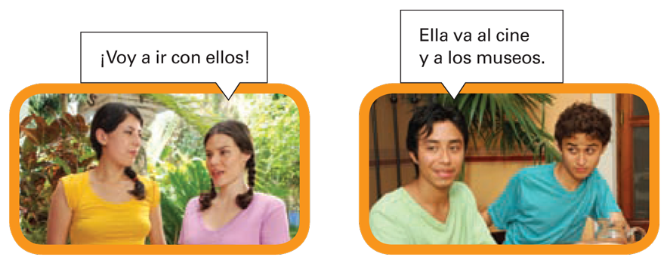
The construction ir a + [infinitive] is used to talk about actions that are going to happen in the future. It is equivalent to the English to be going + [infinitive].

Slide 4
Vamos a + [infinitive] can also express the idea of let’s (do something).

Slide 5
Provide the present tense forms of ir. The first item has been done for you.
Ellos ____. Yo ____. Tu novio ____. Adela ____. | Mi prima y yo ____. Tú ____. Ustedes ____. Nosotros ____. | Usted ____. Nosotras ____. Miguel ____. Ellas ____.
van

