Slide 1
Los verbos reflexivos
Decscubre 3 Lección 2 estructura 2.3

Slide 2
Los verbos reflexivos
In a reflexive construction, the subject of the verb both performs and receives the action.
In other words, it’s something that one does to his or her self.
Reflexive verbs require reflexive pronouns
me nos
te os
se se

Slide 3
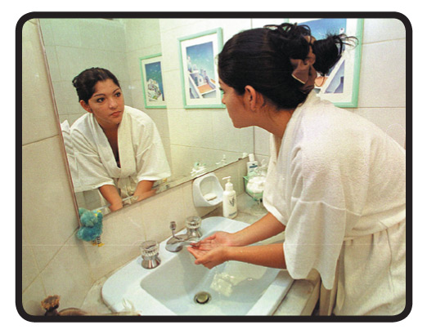
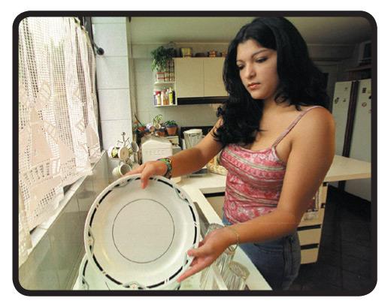
Reflexive verb | Non-reflexive verb
Elena se lava la cara. | Elena lava los platos.

Slide 4
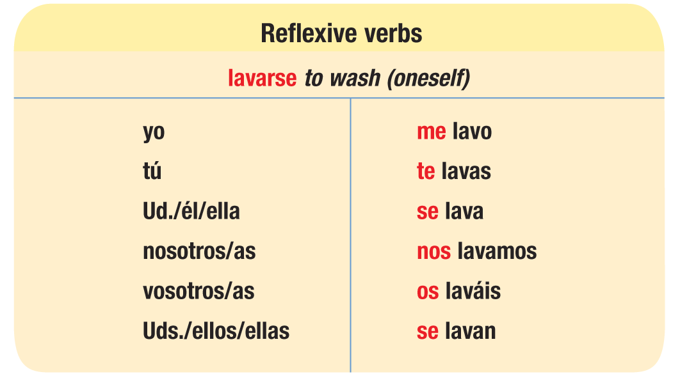

Slide 5
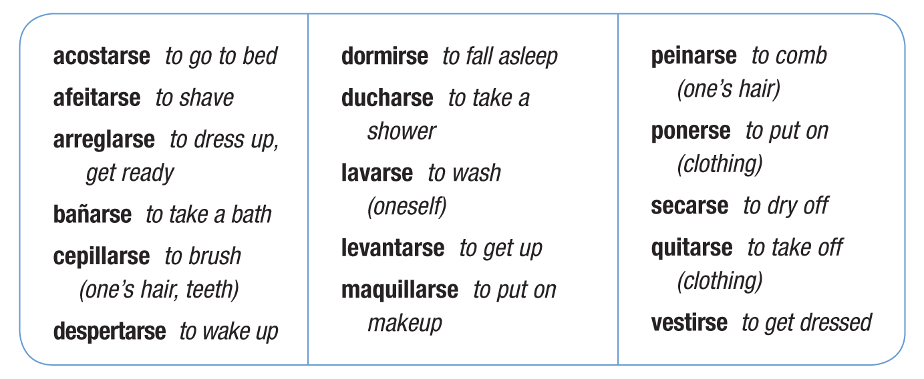
Many of the verbs used to describe daily routines and personal care are reflexive.

Slide 6
In Spanish, most transitive verbs can also be used as reflexive verbs to indicate that the subject performs the action to or for himself or herself.
A transitive verb takes an object. An intransitive verb does not take an object.
Transitive:
Mariela compró dos boletos.
Mariela bought two tickets.
Intransitive:
Johnny nació en México.
Johnny was born in Mexico.
¡ATENCIÓN!

Slide 7
Por ejemplo:
Félix divirtió a los invitados con sus chistes. | Félix se divirtió en la fiesta.
Félix amused the guests with his jokes. | Félix had fun at the party.

Slide 8
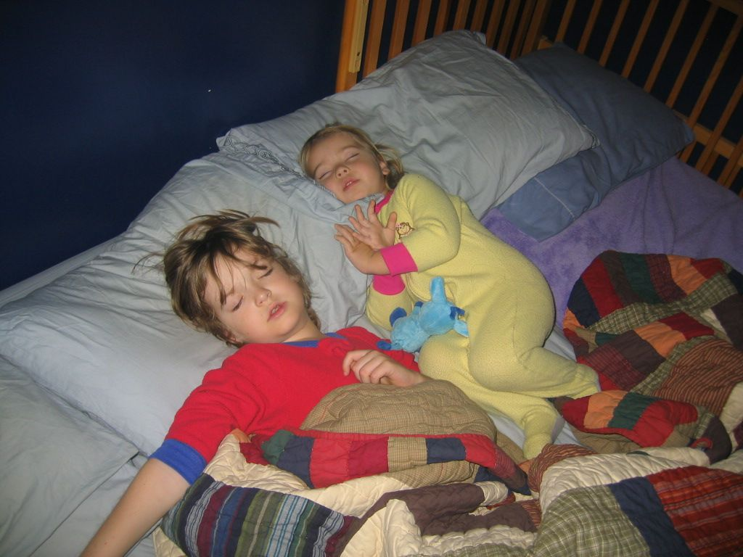
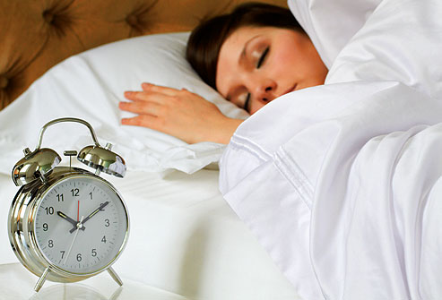
Por ejemplo:
Ana acostó a los gemelos antes de las nueve. | Ana se acostó muy tarde.
Ana put the twins to bed before nine. | Ana went to bed very late.

Slide 9
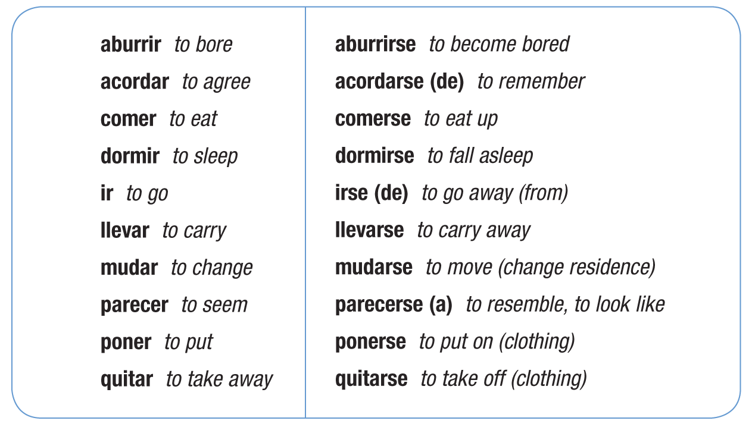
Many verbs change meaning when they are used reflexively.

Slide 10
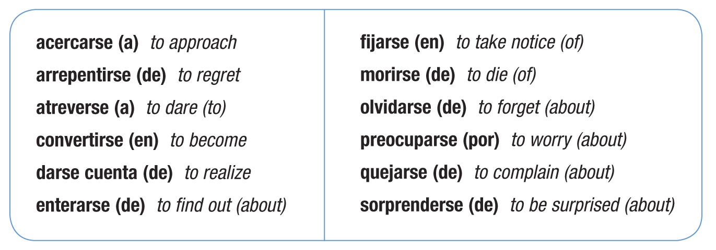
Some Spanish verbs and expressions are reflexive even though their English equivalents may not be. Many of these are followed by the prepositions a, de, and en.

Slide 11
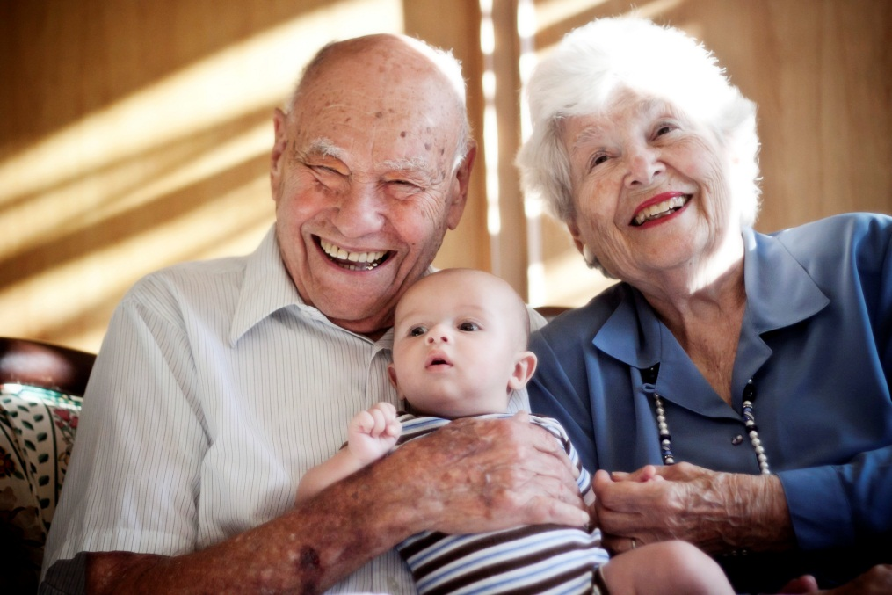
To get or become is frequently expressed in Spanish by the reflexive verb ponerse + [adjective].
Por ejemplo:
Mi hijo se pone feliz cuando nos visitan los abuelos.
My son gets happy when our grandparents visit us.

Slide 12
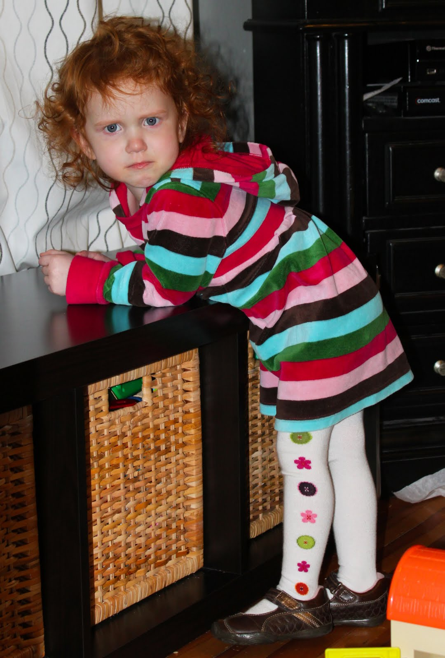
Otro ejemplo:
Si no duermo bien, me pongo insoportable.
If I don’t sleep well, I become unbearable.

Slide 13
In the plural, reflexive verbs can express reciprocal actions done to one another.
¡Mi esposa y yo nos peleamos demasiado!
My wife and I fight too much!
¿Será porque ustedes no se respetan?
Could it be because you don’t respect each other?

Slide 14
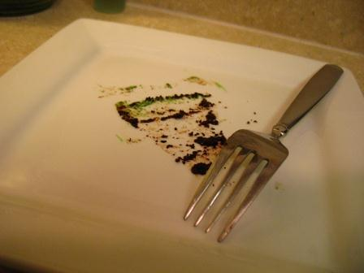
The reflexive pronoun precedes the direct object pronoun when they are used together in a sentence.
¿Te comiste el pastel? | Sí, me lo comí todo.
Did you eat the whole cake? | Yes, I ate it all up.

