Slide 1
El subjuntivo (adjective clauses)
Imagina 4-1 pga. 134-135

Slide 2
When an adjective clause describes an antecedent that is known to exist, use the indicative. When the antecedent is unknown or uncertain, use the subjunctive.

Slide 3
An adjective clause (oración subordinada adjetiva) is a subordinate clause that describes a noun or pronoun, called the antecedent, in the main clause.
¡ATENCIÓN!

Slide 4
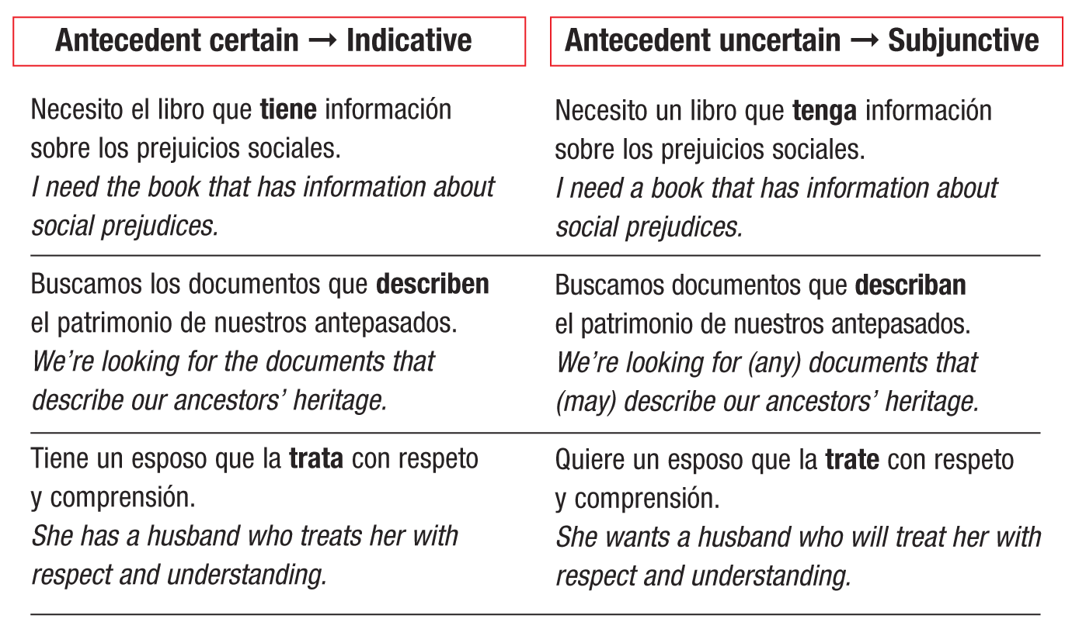

Slide 5
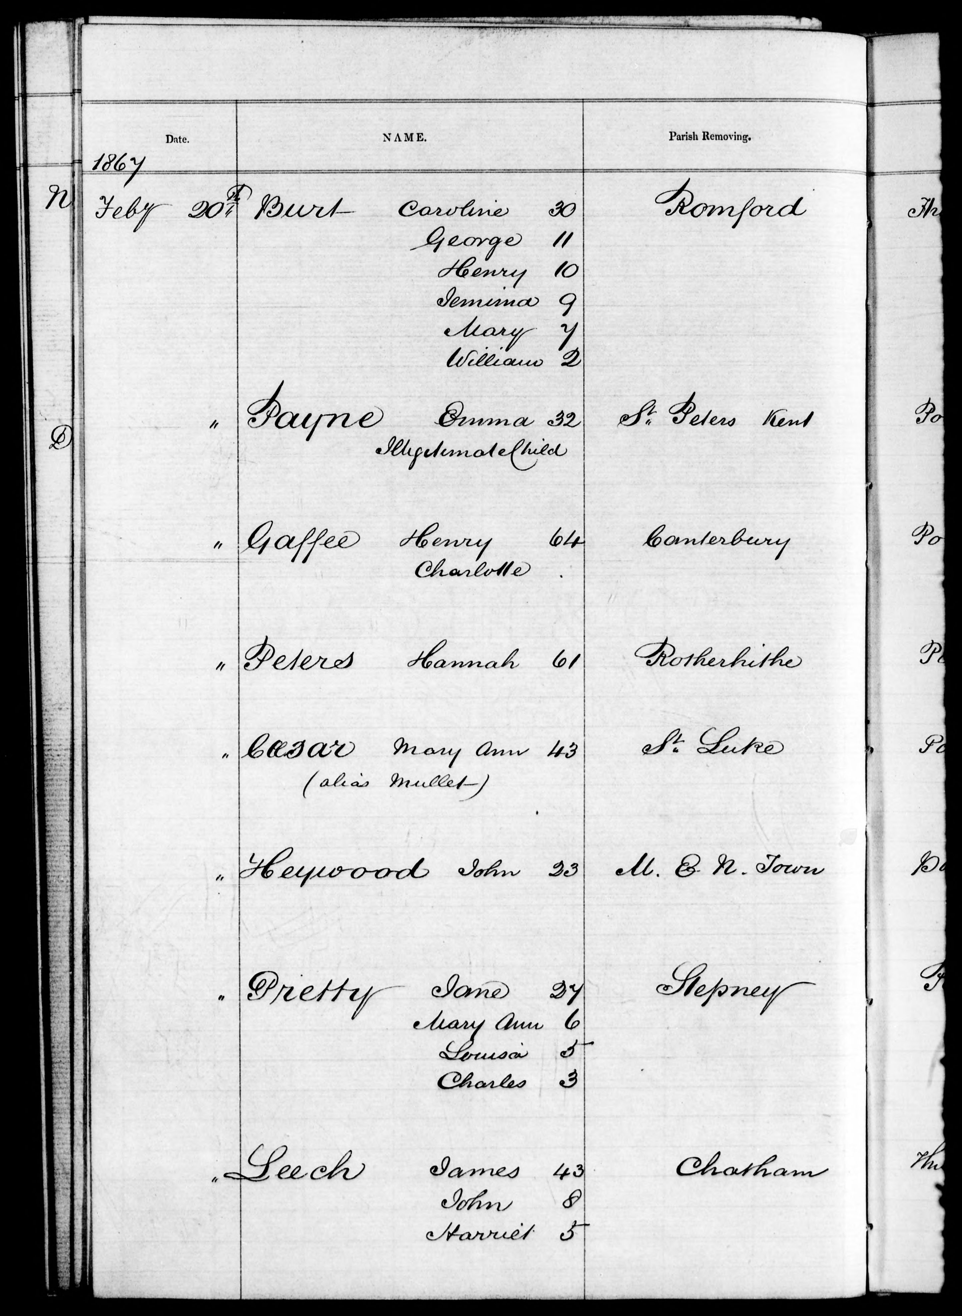

Slide 6
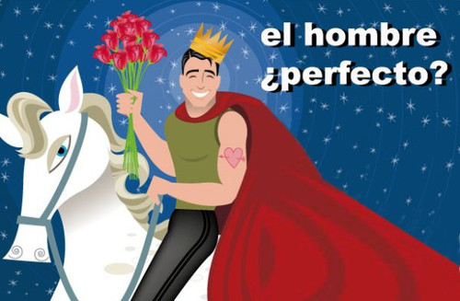

Slide 7
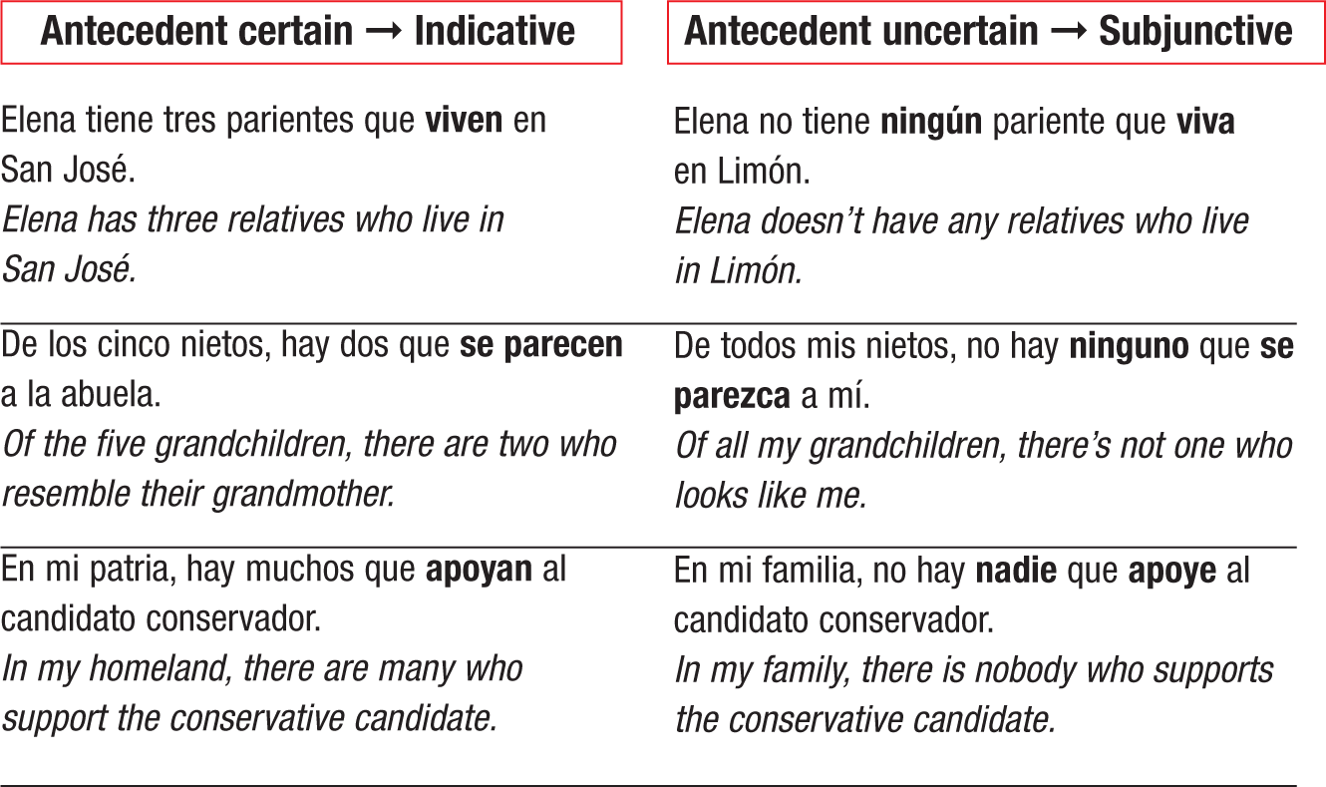
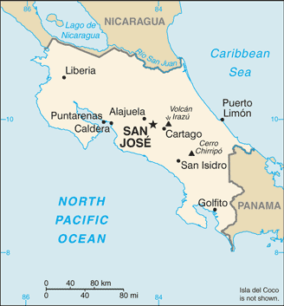
When the antecedent of an adjective clause is a negative pronoun (nadie, ninguno/a), the subjunctive is used.

Slide 9
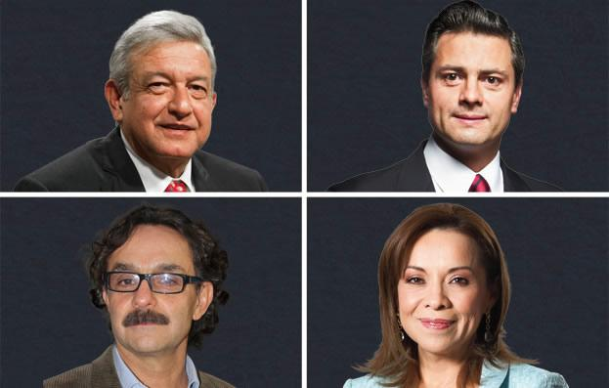

Slide 10
Do not use the personal a with direct objects that represent hypothetical persons.
Antecedent uncertain ➙ Subjunctive
Antecedent certain ➙ Indicative
Busco un abogado que sea honrado.
I’m looking for a lawyer who is honest.
Conozco a un abogado que es honrado, justo e inteligente.
I know a lawyer who is honest, fair, and smart.

Slide 11
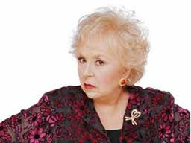
Use the personal a before nadie and alguien, even when their existence is uncertain.
Antecedent uncertain ➙ Subjunctive
Antecedent certain ➙ Indicative
No conozco a nadie que se queje tanto como mi suegra.
I don’t know anyone who complains as much as my mother-in-law.
Yo conozco a alguien que se queja aún más... ¡la mía!
I know someone who complains even more... mine!

Slide 12
The subjunctive is commonly used in questions with adjective clauses when the speaker is trying to find out information about which he or she is uncertain. If the person who responds knows the information, the indicative is used.
Antecedent certain ➙ Indicative
Antecedent uncertain ➙ Subjunctive
Sí, el restaurante de mi yerno está muy cerca y es excelente.
Yes, my son-in-law’s restaurant is nearby, and it’s excellent.
¿Me recomienda usted un buen restaurante que esté cerca de aquí?
Can you recommend a good restaurant that is near here?

Slide 13
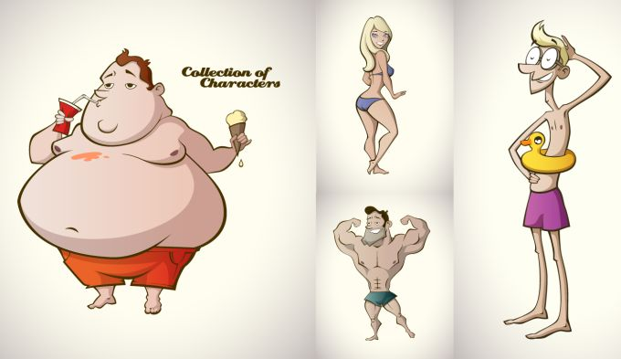
Antecedent uncertain ➙ Subjunctive
Antecedent certain ➙ Indicative
Oigan, ¿no me pueden poner algún apodo que me quede mejor?
Hey guys, can’t you give me a nickname that fits me better?
Bueno, si tú insistes, pero Flaco es el apodo que te queda mejor.
OK, if you insist, but Slim is the nickname that suits you best.

