Slide 1
The verbs tener (to have) and venir (to come) are among the most frequently used in Spanish. Because most of their forms are irregular, you will have to learn each one individually.

Slide 2
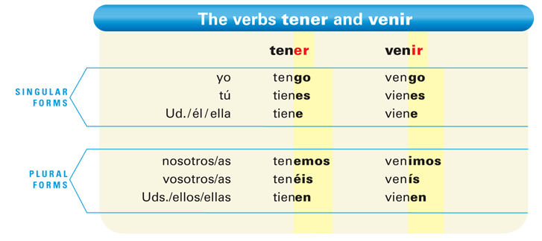

Slide 3
The endings are the same as those of regular -er and -ir verbs, except for the yo forms, which are irregular: tengo, vengo.

Slide 4
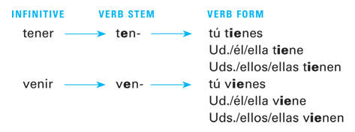
In the tú, Ud., and Uds. forms, the e of the stem changes to ie, as shown below.

Slide 5
Only the nosotros and vosotros forms are regular. Compare them to the forms of comer and escribir that you learned previously.

Slide 6
In certain idiomatic or set expressions in Spanish, you use the construction tener + [noun] to express to be + [adjective]. This chart contains a list of the most common expressions with tener.

Slide 7
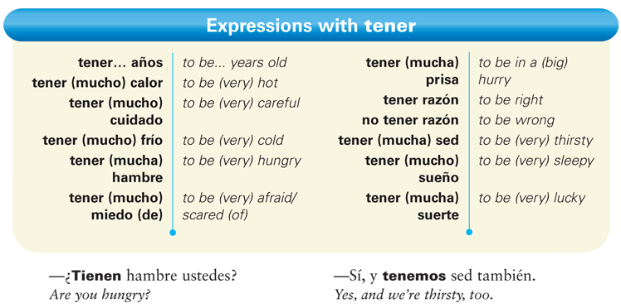

Slide 8
To express an obligation, use tener que (to have to) + [infinitive].

Slide 9
To ask people if they feel like doing something, use tener ganas de (to feel like) + [infinitive].

Slide 10
Provide the appropriate forms of tener and venir. The first item in each column has been done for you.
Ellos ________ dos hermanos. Yo _____ una hermana. El artista _____ tres primos. Nosotros _____ diez tíos. Eva y Diana _____ un sobrino. Usted _____ cinco nietos. Tú _____ dos hermanastras. Ustedes _____ cuatro hijos. Ella _____ una hija. | Mis padres ________ de México. Tú _____ de España. Nosotras _____ de Cuba. Pepe _____ de Italia. Yo _____ de Francia. Ustedes _____ del Canadá. Alfonso y yo _____ de Portugal. Ellos _____ de Alemania. Usted _____ de Venezuela.
tener
venir
tienen
vienen

