Slide 1
In Lección 2, you learned how to form the present tense of regular -ar verbs. You also learned about the importance of verb forms, which change to show who is performing the action. The chart below shows the forms from two other important verb groups, -er verbs and -ir verbs.

Slide 2
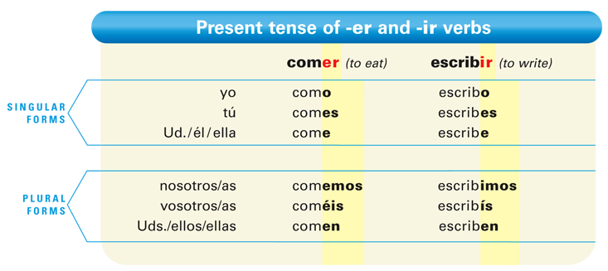

Slide 3
-Er and -ir verbs have very similar endings. Study the preceding chart to detect the patterns that make it easier for you to use them to communicate in Spanish.

Slide 4
Like -ar verbs, the yo forms of -er and -ir verbs end in -o.

Slide 5
Except for the yo form, all of the verb endings for -er verbs begin with -e.

Slide 6
-Er and -ir verbs have the exact same endings, except in the nosotros/as and vosotros/as forms.

Slide 7
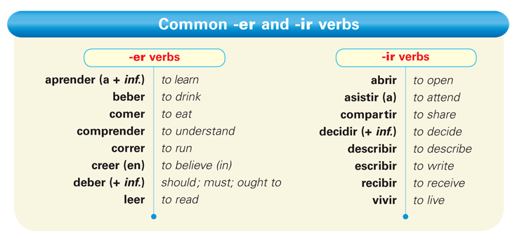

Slide 9
Provide the appropriate present tense forms of these verbs. The first item in each column has been done for you.
Graciela ________. Tú _____. Yo _____. Sara y Ana _____. Usted _____. Ustedes _____. La gente _____. Marcos y yo _____. | Ellos ________ la puerta. Carolina _____ la maleta. Yo _____ las ventanas. Nosotras _____ los libros. Usted _____ el cuaderno. Tú _____ la ventana. Ustedes _____ las maletas. Los muchachos _____ los cuadernos.
correr
correr
abrir
corre
abren

Slide 10
Provide the appropriate present tense forms of these verbs. The first item in each column has been done for you. (cont.)
Él __________ español. Maribel y yo _____ inglés. Tú _____ japonés. Tú y tu hermanastra _____ francés. Mi hijo _____ chino. Yo _____ alemán. Usted _____ inglés. Nosotros _____ italiano.
aprender
correr
aprende

