Slide 1
El subjuntivo y los usos
Descubre 3 Lección 4.1
pga. 154-156

Slide 2
el presente del subjuntivo
Negative tú, Ud. and Uds. commands are actually forms of the present subjunctive.
This means that you will follow the same steps to form the present subjunctive as you did to form those commands.

Slide 3
los usos del subjuntivo
El subjuntivo is used mainly in the subordinate clause of multiple-clause sentences to express will, influence, emotion, doubt, or denial. Subjunctive sentences will typically have a change in subject.
The indicative is used to express actions, states, or facts the speaker considers to be certain.
The subjunctive expresses the speaker’s attitude toward events, as well as actions or states that the speaker views as uncertain.
¡ATENCIÓN!

Slide 4
oraciones con el subjuntivo
A sentence using the subjunctive will typically have three parts:
subject #1 with a subjunctive trigger phrase (indicative verb) | que (necessary conjunction to introduce the subjunctive clause) | subject #2 with a subjunctive verb

Slide 5
el presente del subjuntivo
“yo” form of present tense
drop –o ending
add opposite endings
-ar verbs -er/-ir verbs
e | emos
es | éis
e | en
a | amos
as | áis
a | an

Slide 6
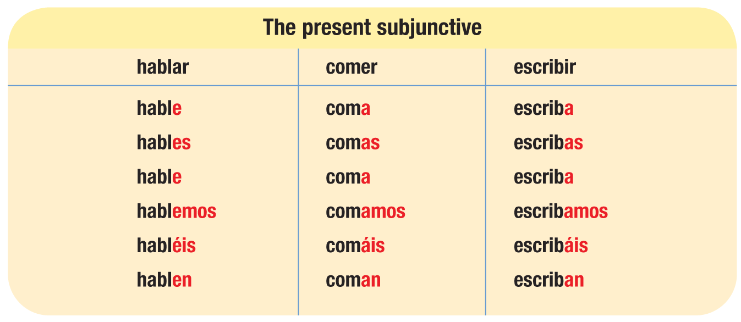
el presente del subjuntivo

Slide 7
el presente del subjuntivo
Verbs with irregular yo forms show that same irregularity in all forms of the present subjunctive.
conocer conozca
decir diga
hacer haga
oír oiga
poner ponga
seguir siga
tener tenga
traer traiga
venir venga
ver vea

Slide 8
el presente del subjuntivo
Verbs with stem changes in the present indicative show the same changes in the present subjunctive. Stem-changing –ir verbs also undergo a stem change in the nosotros/as and vosotros/as forms of the present subjunctive.
pensar (e:ie) piense, pienses, piense, pensemos, penséis, piensen
jugar (u:ue) juegue, juegues, juegue, juguemos, juguéis, jueguen
mostrar (o:ue) muestre, muestres, muestre, mostremos, mostréis, muestren
entender (e:ie) entienda, entiendas, entienda, entendamos, entendáis, entiendan
resolver (o:ue) resuelva, resuelvas, resuelva, resolvamos, resolváis, resuelvan
pedir (e:i/i) pida, pidas, pida, pidamos, pidáis, pidan
sentir (e:ie/i) sienta, sientas, sienta, sintamos, sintáis, sientan
dormir (o:ue/u) duerma, duermas, duerma, durmamos, durmáis, duerman

Slide 9
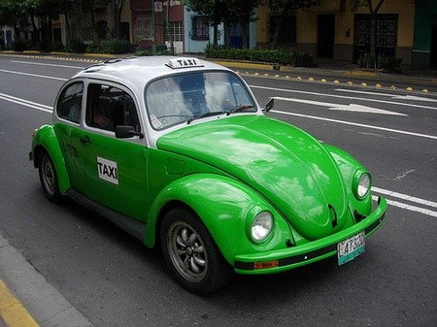
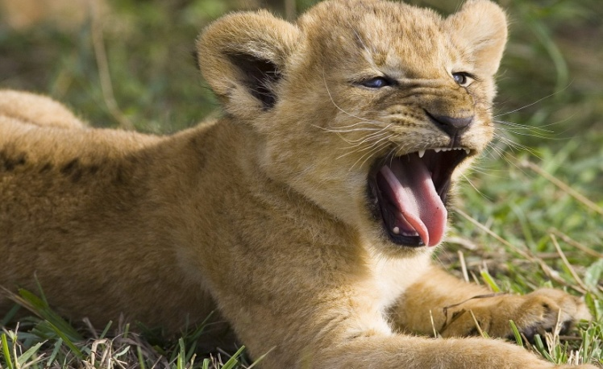
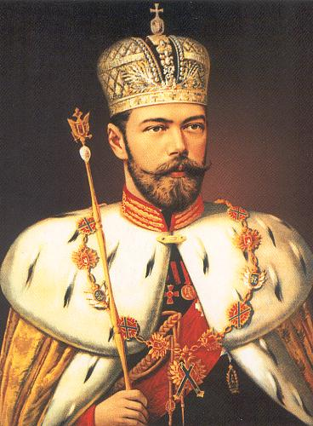
el presente del subjuntivo
Verbs that end in –car, –gar, and –zar undergo spelling changes in the present subjunctive.
sacar: saque jugar: juegue almorzar: almuerce
¡ATENCIÓN!

Slide 10
el presente del subjuntivo
The following six verbs are irregular in the present subjunctive.
dar dé, des, dé, demos, deis, den
estar esté, estés, esté, estemos, estéis, estén
ir vaya, vayas, vaya, vayamos, vayáis, vayan
saber sepa, sepas, sepa, sepamos, sepáis, sepan
ser sea, seas, sea, seamos, seáis, sean
*haber *haya (there could be)

Slide 11
Verbs of will and influence (wishes, hopes, desires)
When the subject of a sentence’s main (independent) clause exerts influence or will on the subject of the subordinate clause, the verb in the subordinate clause takes the subjunctive.

Slide 12
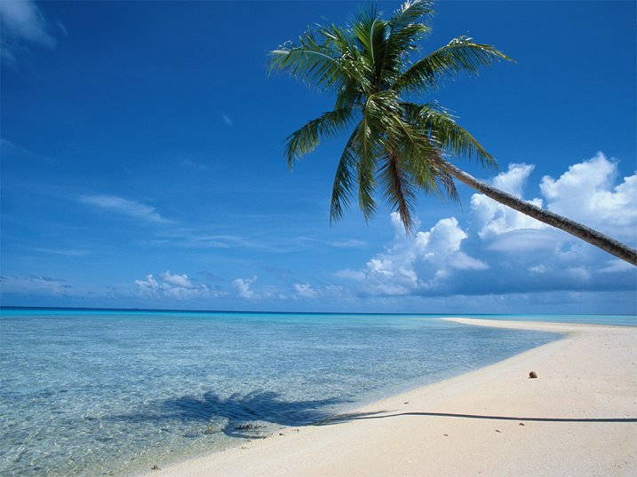
The infinitive, not the subjunctive, is used with verbs and expressions of will and influence if there is no change of subject in the sentence. The que is unnecessary in this case.
Infinitive
Subjunctive
Quiero ir al Caribe en enero.
I want to go to the Caribbean in January.
Prefiero que vayas en marzo.
I prefer that you go in March.

Slide 13
Verbs of will and influence (wishes/desires)
Pedir is used with the subjunctive to ask someone to do something.
Preguntar is used to ask questions, and is not followed by the subjunctive.
No te pido que lo hagas ahora.
I’m not asking you to do it now.
No te pregunto si lo haces ahora.
I’m not asking you if you’re doing it now.
¡ATENCIÓN!

Slide 14
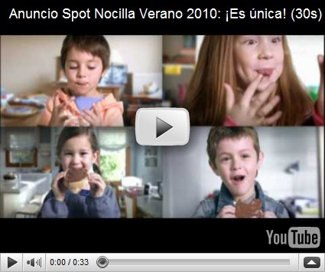
ejemplos
Martín quiere que grabemos este anuncio para el viernes.
Martín wants us to record this ad by Friday.

Slide 15
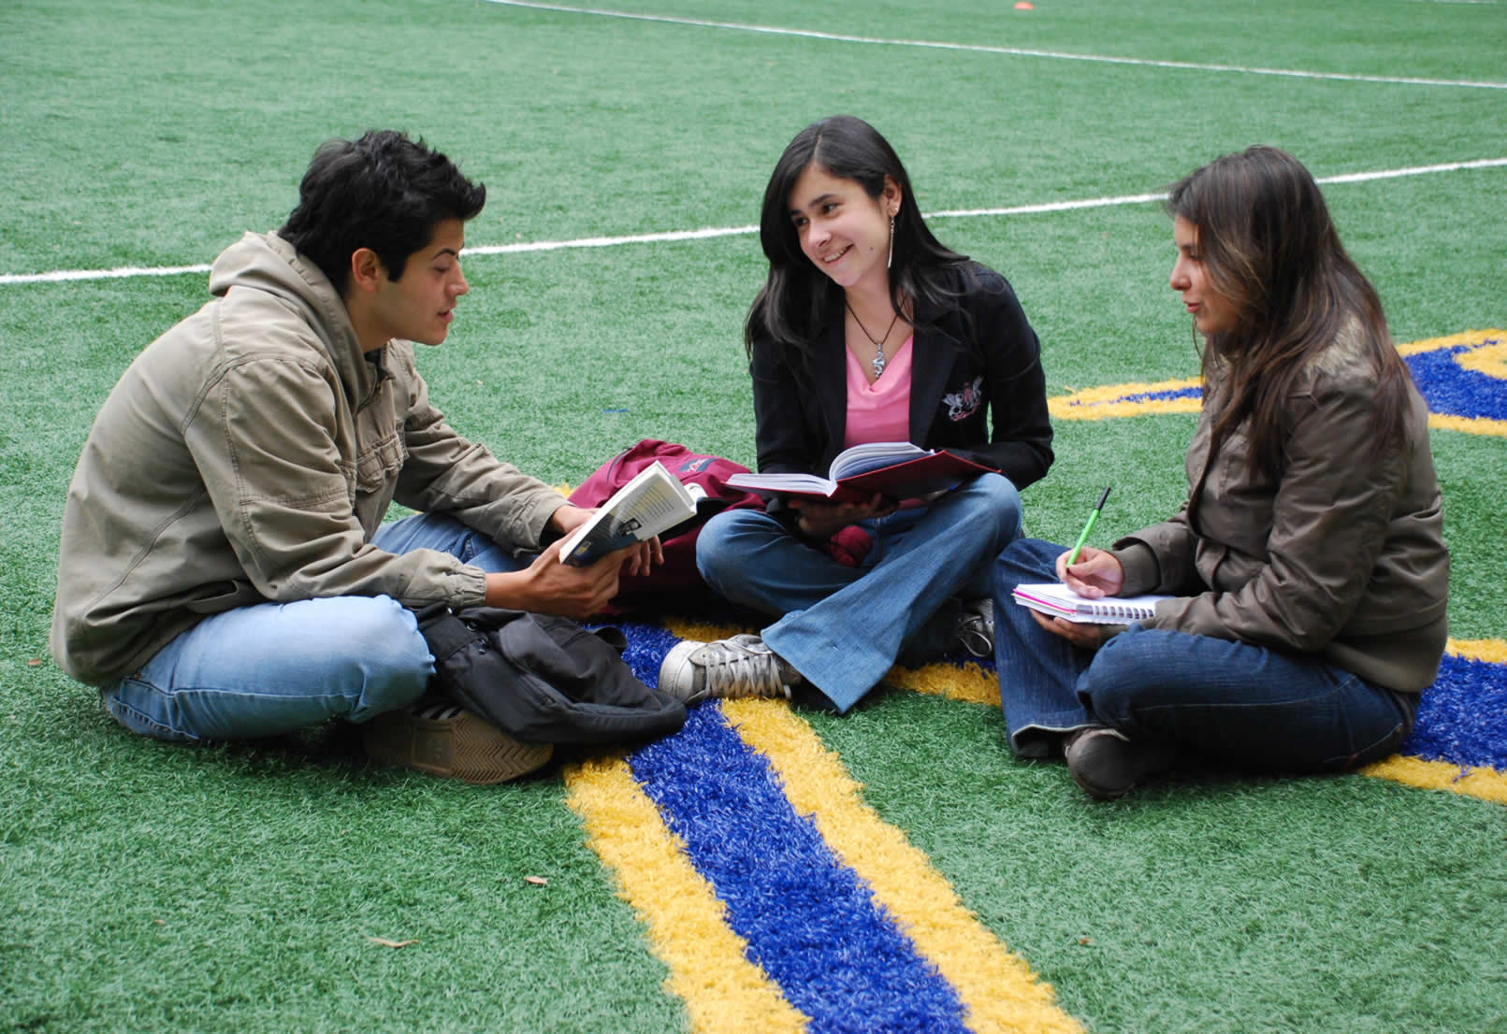
ejemplos
Sra. Burak espera que estudien el vocabulario todos los días.
Sra. Burak hopes that the students study their vocabulary every day.

Slide 16
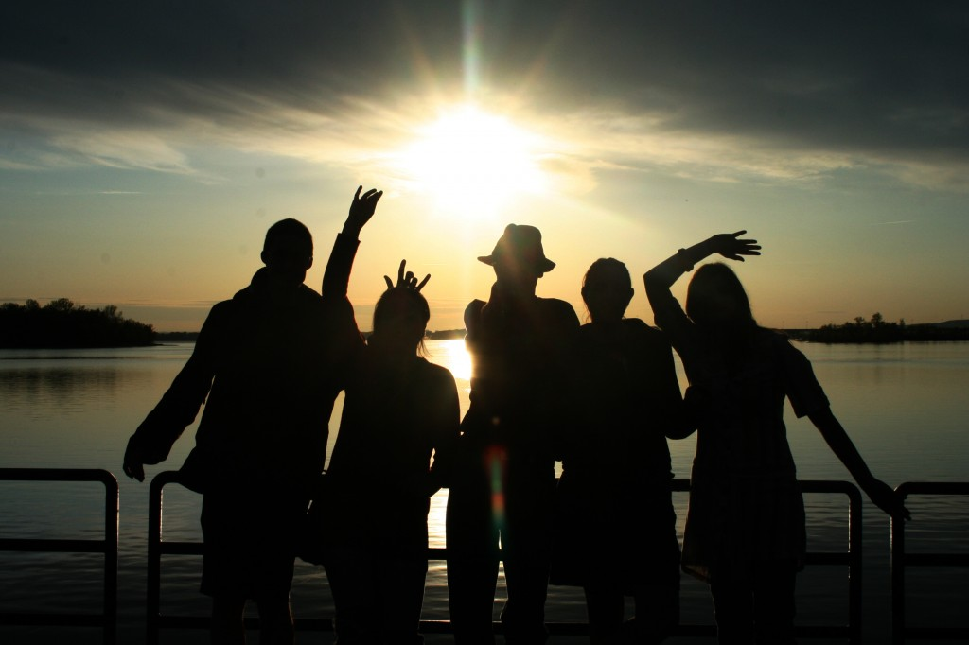
ejemplos
Tus padres se oponen a que salgas tan tarde por la noche.
Your parents object to your going out so late at night.

Slide 17
Verbos de emoción
When the main clause expresses an emotion like hope, fear, joy, pity, or surprise, the verb in the subordinate clause must be in the subjunctive if its subject is different from that of the main clause.

Slide 18
The infinitive, not the subjunctive, is used with verbs and expressions of emotion if there is no change of subject in the sentence. The que is unnecessary in this case.
Infinitivo
Subjunctivo
No me gusta llegar tarde.
I don’t like to arrive late.
Me molesta que la clase no termine a tiempo.
It bothers me that the class doesn’t end on time.

Slide 19
Verbos de emoción
The subjunctive is also used with expressions of emotion that begin with ¡Qué… (What a…!/It’s so…!)
¡Qué pena que él no vaya!
What a shame he’s not going!
¡ATENCIÓN!

Slide 20
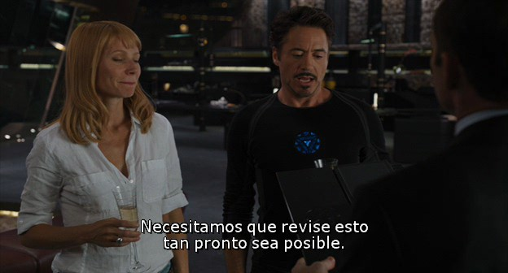
Ejemplo
Espero que la película tenga subtítulos.
I hope the movie has subtitles.

Slide 21
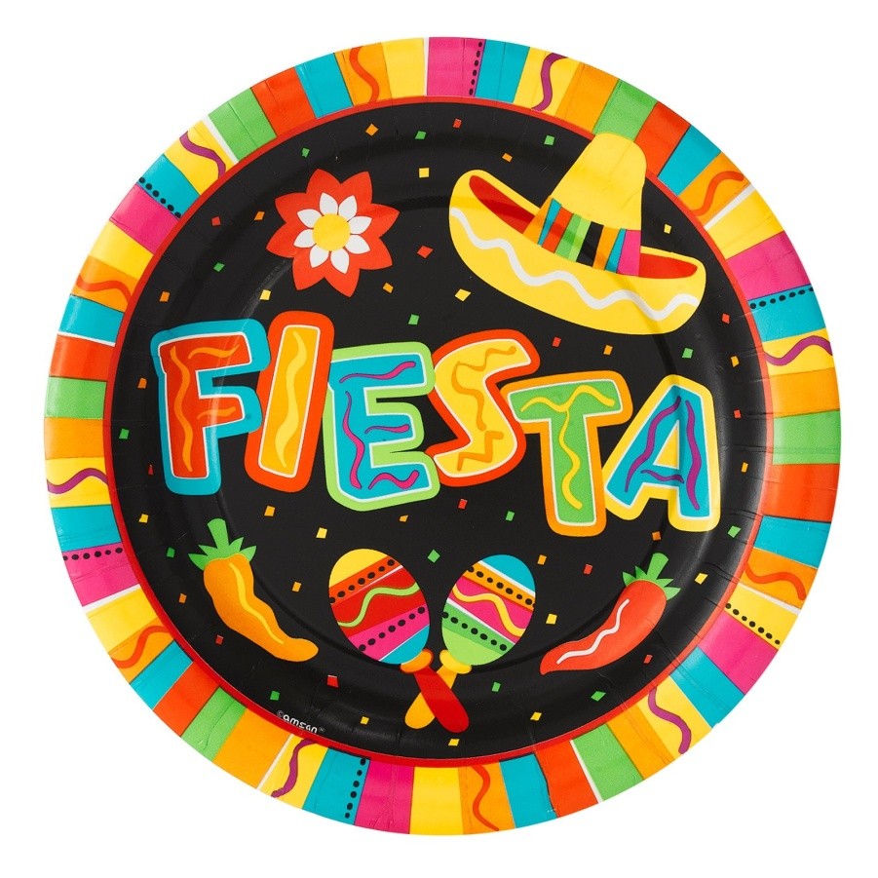
Ejemplo
Es una lástima que no puedas ir a la fiesta.
It’s a shame you can’t go to the party.

Slide 22
Verbs of doubt or denial
When the main clause implies doubt, uncertainty, or denial, the verb in the subordinate clause must be in the subjunctive if its subject is different from that of the main clause.

Slide 23
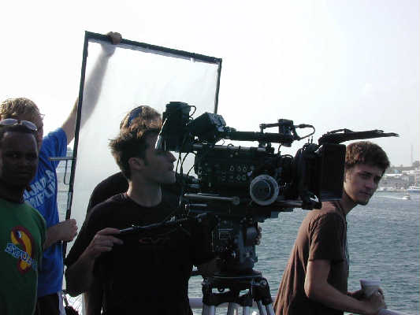
The infinitive, not the subjunctive, is used with verbs and expressions of doubt or denial if there is no change in the subject of the sentence. The que is unnecessary in this case.
Es imposible rodar sin los permisos. | Es improbable que rueden sin los permisos.
It’s impossible to shoot the movie without the permits. | It’s unlikely that they’ll shoot the movie without the permits.

Slide 24
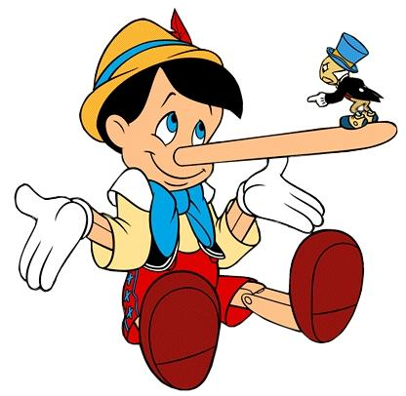
Por ejemplo
No creo que él nos quiera engañar. | Dudan que la novela tenga éxito.
I don’t think that he wants to deceive us. | They doubt that the novel will be successful.

Slide 25
The expression ojalá (I hope; I wish) is always followed by the subjunctive. The use of que with ojalá is optional.
Ojalá (que) no llueva.
I hope it doesn’t rain.
Ojalá (que) no te enfermes.
I hope you don’t get sick.
The subjunctive is also used after quizás and tal vez (maybe, perhaps) when they signal uncertainty.
Quizás vengan a la fiesta.
Maybe they’ll come to the party.
¡ATENCIÓN!

Slide 26
Verbos impersonales
Some subjunctive phrases are based on general observations, meaning that the main clause does not have a specific subject. Many of the impersonal observation triggers encompass wishes, hopes, desires, emotion and doubts. The subjunctive is required in the subordinate clause because a specific subject is specified.

Slide 27
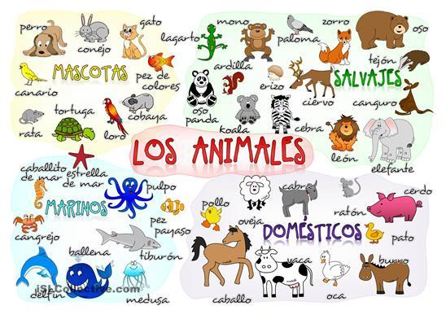
Por ejemplo
Es malo que los estudiantes no estudien el vocabulario de español a menudo.
It’s bad that the students don’t study their Spanish vocabulary often.

Slide 28
¡OJO!
Phrases that express certainty or fact use the indicative, NOT the subjunctive!
Examples include:
Creer que
Pensar que
Es cierto que
Es verdad que

