Slide 1
los mandatos/imperativos
Imagina Lección 3

Slide 2
Mandatos formales (Ud. y Uds.)
Mandatos formales are used to give orders or advice to people you address as usted or ustedes.
To form the Ud. and Uds. command forms:
  Take the present tense “yo” form
  Drop the –o ending
  Add one of the following endings:
 | -ar verbs | -er/-ir verbs
Usted (Ud.) | -e | -a
Ustedes (Uds.) | -en | -an

Slide 3
Mandatos formales- las reglas
Note that the formal command forms use the vowel opposite that which is usually associated with the conjugation.
Verbs with irregularities in the “yo” form (stem-changes, -go verbs, irregular “yo” forms) have that same irregularity in the formal command forms.
-Ar verbs ending in –gar, -car and –zar will have the same spelling changes in the command form that they have in the preterite tense “yo” form.

Slide 4
Mandatos formales -más reglas
To make a formal command negative, place “no” before the verb.
If you choose to use the subject pronoun Ud. or Uds. with the command form, place the pronoun after the command.

Slide 5
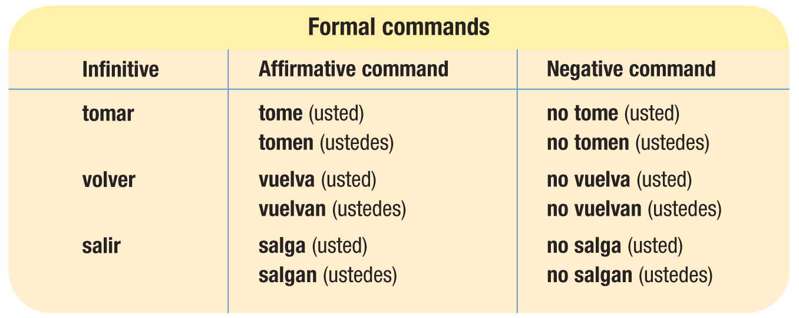
Mandatos formales- ejemplos

Slide 6

Ejemplos
Open the door, don’t close the window. (Ud.)
Abra (Ud.) la puerta, no cierre la ventana.

Slide 7

Ejemplos
You guys do the homework, don’t go out.
Hagan (Uds.) la tarea, no salgan.

Slide 8
Mandatos formales- los irregulares
There are only 5 verbs that are irregular in the formal command form.
 | Ud. form | Uds. form
dar | dé | den
estar | esté | estén
ir | vaya | vayan
saber | sepa | sepan
ser | sea | sean

Slide 9
Ejemplos
You guys be smart, don’t be stupid.
Sean inteligentes, no sean estúpidos.

Slide 10
Ejemplos
Give expensive presents, don’t give cheap presents. (Ud.)
Dé regalos caros, no dé regalos baratos.

Slide 11
Mandatos informales
Informal commands (tú form commands) are used when giving orders or advice to friends, family, people you know well and children.
Unlike the formal commands, informal commands have different forms for positive commands and negative commands.

Slide 12
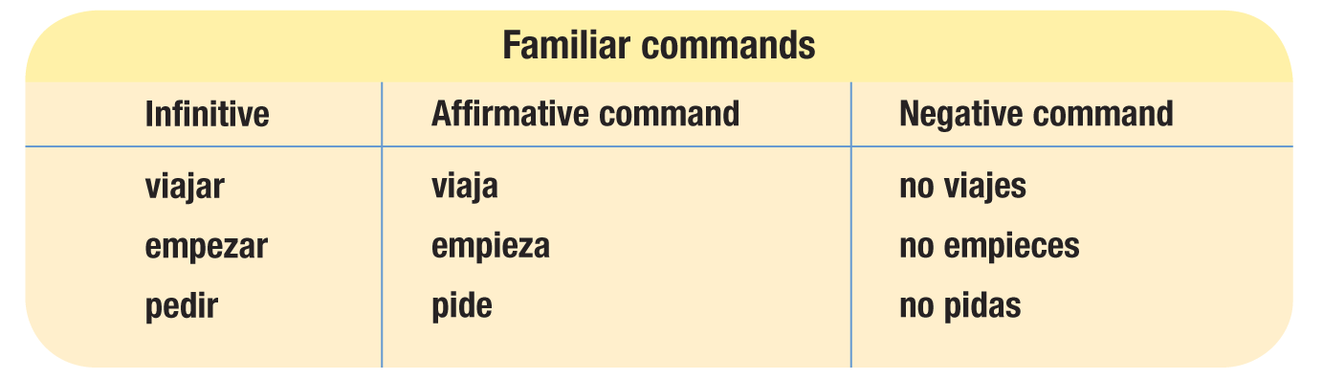
Mandatos informales- los positivos
To form positive tú form commands, use the third person present tense form (including stem-changes).
Por ejemplo:

Slide 13
Ejemplos (+ tú)
Start the homework!
¡Empieza la tarea!

Slide 14

Ejemplos (+ tú)
Study Spanish!
¡Estudia el español!

Slide 15
Mandatos formales- irregulares de los positivos
The following verbs have irregular positive tú command forms:
 | Irregular positive tú commands
tener | ten
venir | ven
poner | pon
salir | sal
decir | di
ser | sé
ir | ve
hacer | haz

Slide 16
Ejemplos (+ tú)
Do the homework!
¡Haz la tarea!

Slide 17
Ejemplos (+ tú)
Come here!
¡Ven aquí!

Slide 18
Mandatos informales- los negativos
To order or advise friends, family, people you know well and children NOT to do something, use the negative tú form commands.
Negative tú form commands are formed the same way as Ud. and Uds. form commands and follow the same rules.
  Take the “yo” form of the present tense
  Drop the –o ending
  Add –es to –ar verbs and –as to –er/-ir verbs
  Place “no” in front of the command form

Slide 19

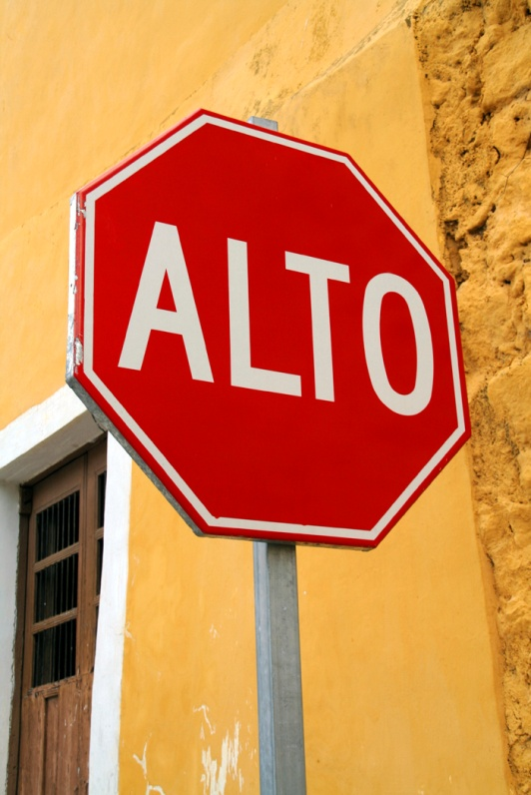
Ejemplos (-tú)
Don’t leave!
¡No salgas!

Slide 20
Ejemplos (-tú)
Don’t order the fish!
¡No pidas el pescado!

Slide 21
Mandatos informales- irregulares de los negativos
The same verbs that are irregular in the Ud. and Uds. form commands are also irregular in the negative tú form commands.
 | Irregular negative tú commands
dar | des
estar | estés
ir | vayas
saber | sepas
ser | seas

Slide 22
Ejemplos (-tú)
Don’t go to the store today.
No vayas a la tienda hoy.

Slide 23
Ejemplos (-tú)
Don’t give bad advice. (consejos)
No des consejos malos.

Slide 24
¡ATENCIÓN!
Vosotros/as commands
In Latin America, ustedes commands serve as the plural of familiar (tú) commands. The familiar plural vosotros/as command is used in Spain. The affirmative command is formed by changing the –r of the infinitive to –d. The negative command is identical to the vosotros/as form of the present subjunctive.
bailar: bailad/no bailéis
For reflexive verbs, affirmative commands are formed by dropping the –r and adding the reflexive pronoun –os. In negative commands, the pronoun precedes the verb.
levantarse: levantaos/no os levantéis
Irse is irregular: idos/no os vayáis

Slide 25
Mandatos- nosotros/as
Nosotros/as commands are used to give orders or suggestions that include yourself as well as others. They correspond to the English let’s + [verb].
To form positive and negative nosotros/as commands:
  Take the present tense “yo” form
  Drop the –o ending
  Add –emos to –ar verbs and –amos to –er/-ir verbs

Slide 26
Mandatos- nosotros/as
Notas importantes:
  Nosotros/as commands can also be expressed using vamos.
    Por ejemplo: ¡Vamos a comer!
  The verb ir
    Two possible positive forms
      vayamos
      vamos (more commonly used)
    Negative form = no vayamos

Slide 27
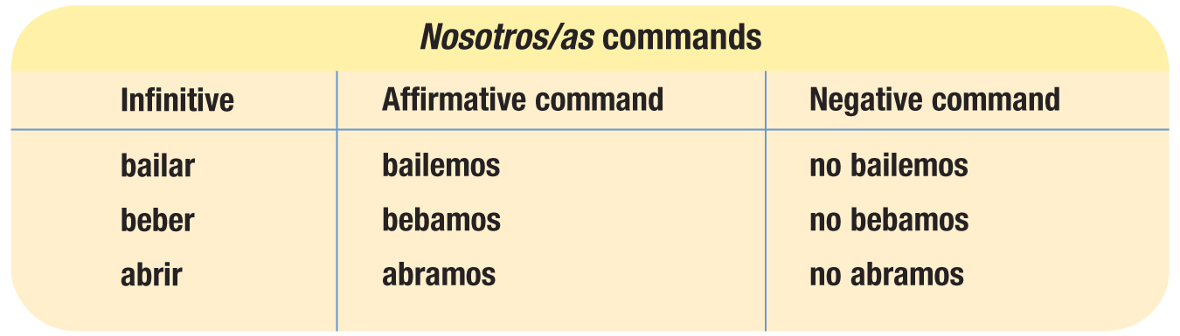
Mandatos- nosotros/as
Por ejemplo:

Slide 28


Los mandatos con pronombres
When object and reflexive pronouns are used with affirmative commands, they are always attached to the verb.
  Dame el libro.
  Dámelo.
When used with negative commands, the pronouns appear between no and the verb.
  No me digan las mentiras.
  No me las digan.

Slide 29
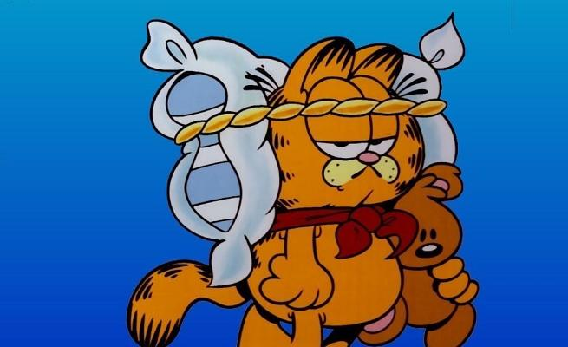

Los mandatos con pronombres
Ejemplos:
Levántense temprano.
No se levanten temprano.
Dímelo todo.
No me lo digas.

Slide 30

Los mandatos con pronombres
When the pronouns nos or se are attached to an affirmative nosotros/as command, the final s of the command form is dropped.
Por ejemplo:
  Sentémonos aquí.
  No nos sentemos aquí.
  Démoselo mañana.
  No se lo demos mañana.

Slide 31
Los mandatos con pronombres
When one or more pronouns are attached to an affirmative command, an accent mark may be necessary to maintain the command form’s original stress. This usually happens when the combined verb form has three or more syllables.
decir:
di, dile, dímelo
diga, dígale, dígaselo
digamos, digámosle, digámoselo
¡ATENCIÓN!

