Slide 1
El subjuntivo y los usos
Imagina Lección 3.1
pga. 94-96

Slide 2
el presente del subjuntivo
Negative tú, Ud. and Uds. commands are actually forms of the present subjunctive.
This means that you will follow the same steps to form the present subjunctive as you did to form those commands.

Slide 3
los usos del subjuntivo
El subjuntivo is used mainly in the subordinate clause of multiple-clause sentences to express will, influence, emotion, doubt, or denial. Subjunctive sentences will typically have a change in subject.
The indicative is used to express actions, states, or facts the speaker considers to be certain.
The subjunctive expresses the speaker’s attitude toward events, as well as actions or states that the speaker views as uncertain.
¡ATENCIÓN!

Slide 4
oraciones con el subjuntivo
A sentence using the subjunctive will typically have three parts:
subject #1 with a subjunctive trigger phrase (indicative verb) | que (necessary conjunction to introduce the subjunctive clause) | subject #2 with a subjunctive verb

Slide 5
el presente del subjuntivo
“yo” form of present tense
drop –o ending
add opposite endings
-ar verbs -er/-ir verbs
e | emos
es | éis
e | en
a | amos
as | áis
a | an

Slide 6
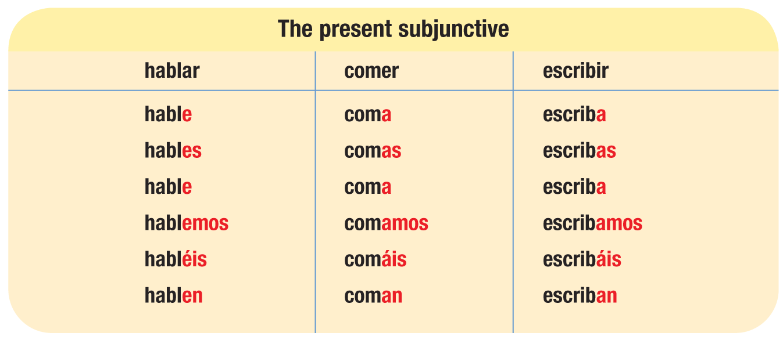
el presente del subjuntivo

Slide 7
el presente del subjuntivo
Verbs with irregular yo forms show that same irregularity in all forms of the present subjunctive.
conocer conozca
decir diga
hacer haga
oír oiga
poner ponga
seguir siga
tener tenga
traer traiga
venir venga
ver vea

Slide 8
el presente del subjuntivo
Verbs with stem changes in the present indicative show the same changes in the present subjunctive. Stem-changing –ir verbs also undergo a stem change in the nosotros/as and vosotros/as forms of the present subjunctive.
pensar (e:ie) piense, pienses, piense, pensemos, penséis, piensen
jugar (u:ue) juegue, juegues, juegue, juguemos, juguéis, jueguen
mostrar (o:ue) muestre, muestres, muestre, mostremos, mostréis, muestren
entender (e:ie) entienda, entiendas, entienda, entendamos, entendáis, entiendan
resolver (o:ue) resuelva, resuelvas, resuelva, resolvamos, resolváis, resuelvan
pedir (e:i/i) pida, pidas, pida, pidamos, pidáis, pidan
sentir (e:ie/i) sienta, sientas, sienta, sintamos, sintáis, sientan
dormir (e:ue/u) duerma, duermas, duerma, durmamos, durmáis, duerman

Slide 9
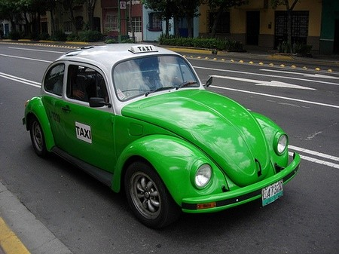
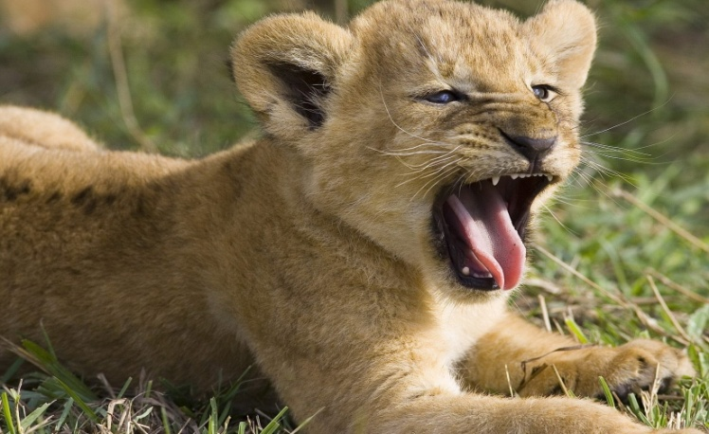
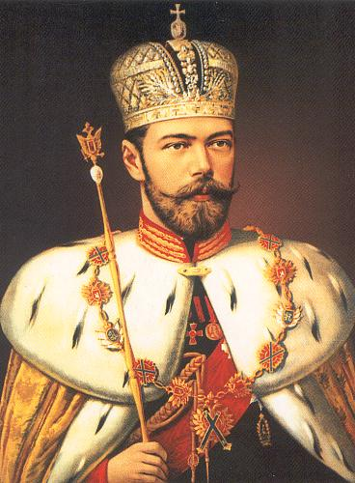
el presente del subjuntivo
Verbs that end in –car, –gar, and –zar undergo spelling changes in the present subjunctive.
sacar: saque jugar: juegue almorzar: almuerce
¡ATENCIÓN!

Slide 10
el presente del subjuntivo
The following six verbs are irregular in the present subjunctive.
dar dé, des, dé, demos, deis, den
estar esté, estés, esté, estemos, estéis, estén
ir vaya, vayas, vaya, vayamos, vayáis, vayan
saber sepa, sepas, sepa, sepamos, sepáis, sepan
ser sea, seas, sea, seamos, seáis, sean
*haber *haya (there could be)

