Slide 1
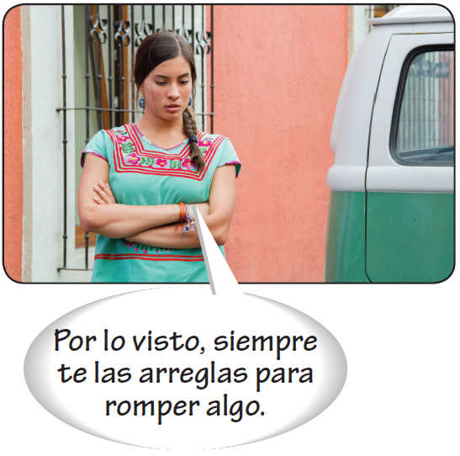
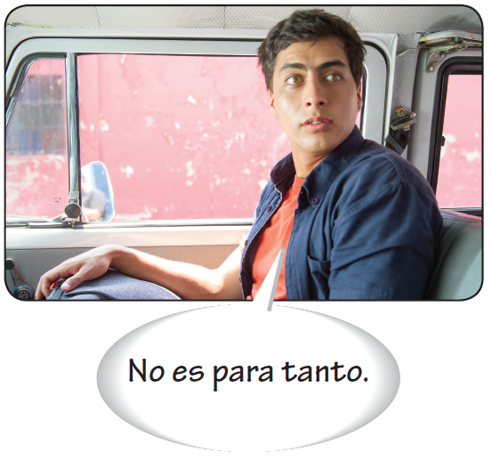
Por and para
Por and para are both translated as for, but they are not interchangeable.

Slide 2
Por and para
Uses of para
Destination (toward; in the direction of) | El cirujano sale de su casa para la clínica a las ocho. The surgeon leaves his house at eight to go to the clinic.
Goal (para + [infinitive]) (in order to) | El resultado del análisis va a estar listo para mañana. The test results will be ready by tomorrow.
Deadline or a specific time in the future (by; for) | El doctor usó un termómetro para ver si el niño tenía fiebre. The doctor used a thermometer to see if the boy had a fever.
Purpose (para + [noun]) (for; used for) | El investigador descubrió una cura para la enfermedad. The researcher discovered a cure for the disease.
Recipient (for) | La enfermera preparó la cama para doña Ángela. The nurse prepared the bed for Doña Ángela.
Comparison with others or opinion (for; considering) | Para su edad, goza de muy buena salud. For her age, she enjoys very good health.
 | Para mí, lo que tienes es gripe y no un resfriado. To me, what you have is the flu, not a cold.
Employment (for) | Mi hijo trabaja para una empresa farmacéutica. My son works for a pharmaceutical company.

Slide 3
Por and para
Expressions with para
no estar para bromas to be in no mood for jokes | para que so that
no ser para tanto to not be a big deal | para que (lo) sepas just so you know
para colmo to top it all off | para siempre forever
Note that the expression para que is followed by the subjunctive.
Te compré zapatos de tenis para que hagas ejercicio.
I got you sneakers so that you will work out.

Slide 4
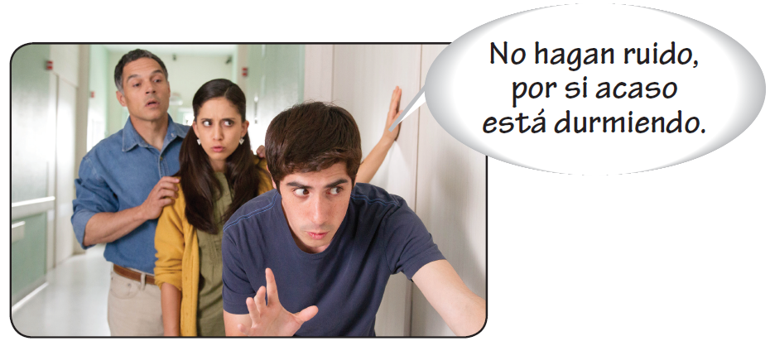
Por and para

Slide 5
Por and para
Uses of por
Motion or a general location (along; through; around; by) | Me quebré la pierna corriendo por el parque. I broke my leg running through the park.
Duration of an action (for; during; in) | Estuvo en cama por dos meses. He was in bed for two months.
Reason or motive for an action (because of; on account of; on behalf of) | Rezó por su hijo enfermo. She prayed for her sick child.
Object of a search (for; in search of) | El enfermero fue por un termómetro. The nurse went to get a thermometer.
Means by which (by; by way of; by means of) | Consulté con el doctor por teléfono. I consulted with the doctor by phone.
Exchange or substitution (for; in exchange for) | Cambiamos ese tratamiento por uno nuevo. We changed from that treatment to a new one.
Unit of measure (per; by) | Tengo que tomar las pastillas cinco veces por día. I have to take the pills five times a day.
Agent (passive voice) (by) | La nueva política de salud pública fue anunciada por la prensa. The new public health policy was announced by the press.

Slide 6
Por and para
Expressions with por
por ahora for the time being | por lo general in general
por allí/aquí around there/here | por lo menos at least
por casualidad by chance | por lo tanto therefore
por cierto by the way | por lo visto apparently
¡Por Dios! For God’s sake! | por más/mucho que no matter how much
por ejemplo for example | por otro lado/otra parte on the other hand
por escrito in writing | por primera vez for the first time
por eso therefore; for that reason | por si acaso just in case
por fin finally | por supuesto of course

Slide 7
Por and para
¡ATENCIÓN!
In many cases it is grammatically correct to use either por or para in a sentence. However, the meaning of each sentence is different.
Trabajó por su tío. He worked for (in place of) his uncle.
Trabajó para su tío. He worked for his uncle(’s company).

