Slide 1
Commands
Formal (Ud. and Uds.) commands
Formal commands (mandatos) are used to give orders or advice to people you address as usted or ustedes. Their forms are identical to the present subjunctive forms for usted and ustedes.
Formal commands
Infinitive | Affirmative command | Negative command
tomar volver salir | tome (usted) tomen (ustedes) vuelva (usted) vuelvan (ustedes) salga (usted) salgan (ustedes) | no tome (usted) no tomen (ustedes) no vuelva (usted) no vuelvan (ustedes) no salga (usted) no salgan (ustedes)

Slide 2
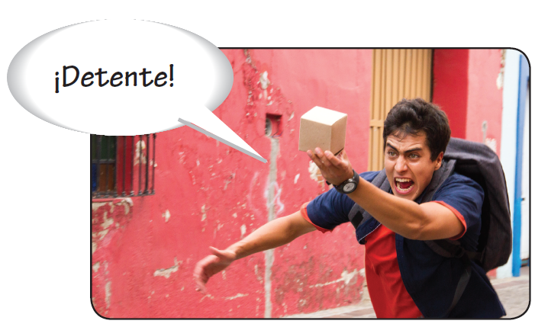
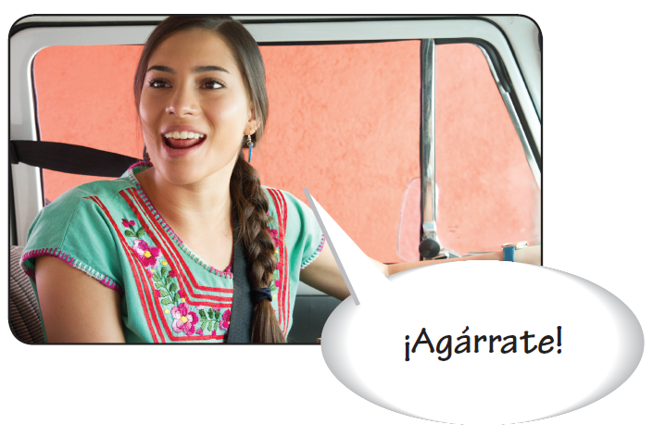
Commands
Familiar (tú) commands
Familiar commands are used with people you address as tú. Affirmative tú commands have the same form as the él, ella, and usted form of the present indicative. Negative tú commands have the same form as the tú form of the present subjunctive.
Familiar commands
Infinitive | Affirmative command | Negative command
viajar empezar pedir | viaja empieza pide | no viajes no empieces no pidas

Slide 3
Commands
These verbs and their derivatives(predecir, deshacer, entretener, etc.) have irregular affirmative tú commands. Their negative forms are still the same as the tú form of the present subjunctive.
decir hacer
ir
poner
di
haz
ve
pon
salir
ser
tener
venir
sal
sé
ten
ven

Slide 4
Commands
¡ATENCIÓN!
Vosotros/as commands
In Latin America, ustedes commands serve as the plural of familiar (tú) commands. The familiar plural vosotros/as command is used in Spain. The affirmative command is formed by changing the -r of the infinitive to -d. The negative command is identical to the vosotros/as form of the present subjunctive.
bailar: bailad/no bailéis
For reflexive verbs, affirmative commands are formed by dropping the -r and adding the reflexive pronoun -os. In negative commands, the pronoun precedes the verb.
levantarse: levantaos/ no os levantéis
The verb irse is irregular: idos/no os vayáis

Slide 5
Commands
Nosotros/as commands
Nosotros/as commands are used to give orders or suggestions that include yourself as well as other people. In Spanish, nosotros/as commands correspond to the English let’s + [verb ]. Affirmative and negative nosotros/as commands are generally identical to the nosotros/as forms of the present subjunctive.
Nosotros/as commands
Infinitive | Affirmative command | Negative command
bailar beber abrir | bailemos bebamos abramos | no bailemos no bebamos no abramos
The nosotros/as commands for ir and irse are irregular: vamos and vámonos. The negative commands are regular: no vayamos and no nos vayamos.

Slide 6
Commands
Using pronouns with commands
When object and reflexive pronouns are used with affirmative commands, they are always attached to the verb. When used with negative commands, the pronouns appear between no and the verb.
Levántense temprano. | No se levanten tarde.
Wake up early. | Don’t wake up late.
Dime todo. | No me digas nada.
Tell me everything. | Don’t tell me anything.

Slide 7
Commands
When the pronouns nos or se are attached to an affirmative nosotros/as command, the final s of the command form is dropped.
Sentémonos aquí. Let’s sit here. Démoselo mañana. Let’s give it to him/her tomorrow. | No nos sentemos aquí. Let’s not sit here. No se lo demos mañana. Let’s not give it to him/her tomorrow.

Slide 8
Commands
¡ATENCIÓN!
When one or more pronouns are attached to an affirmative command, an accent mark may be necessary to maintain the original stress. This usually happens when the combined verb form has three or more syllables.
decir
di, dile, dímelo diga, dígale, dígaselo digamos, digámosle, digámoselo

Slide 9
Commands
Indirect (él, ella, ellos, ellas) commands
The construction que + [subjunctive ] can be used with a third-person form to express indirect commands that correspond to the English let someone do something. If the subject of the indirect command is expressed, it usually follows the verb.
Que pase el siguiente. Let the next person pass. | Que lo haga ella. Let her do it.

Slide 10
Commands
As with other uses of the subjunctive, pronouns are never attached to the conjugated verb, regardless of whether the indirect command is affirmative or negative.
Que se lo den los otros. Que lo vuelva a hacer . | Que no se lo. Que no lo vuelva a hacer.

