Slide 1
The subjunctive in noun clauses
Forms of the present subjunctive
The subjunctive (el subjuntivo) is used mainly in the subordinate (dependent) clause of multiple-clause sentences to express will, influence, emotion, doubt, or denial. The present subjunctive is formed by dropping the –o from the yo form of the present indicative and adding these endings.
The present subjunctive
hablar | comer | escribir
hable hables hable hablemos habléis hablen | coma comas coma comamos comáis coman | escriba escribas escriba escribamos escribáis escriban

Slide 2
The subjunctive in noun clauses
¡ATENCIÓN!
The indicative is used to express actions, states, or facts the speaker considers to be certain. The subjunctive expresses the speaker’s attitude toward events, as well as actions or states that the speaker views as uncertain.

Slide 3
The subjunctive in noun clauses
(continued)
¡ATENCIÓN!
Verbs that end in –car, –gar, and –zar undergo spelling changes in the present subjunctive.
sacar: saque jugar: juegue almorzar: almuerce
●   
The present subjunctive form of hay is haya.
No creo que haya una solución. I don’t think there is a solution.

Slide 4
The subjunctive in noun clauses
Verbs with irregular yo forms show that same irregularity in all forms of the present subjunctive.
conocer
decir
hacer
oír
poner
conozca
diga
haga
oiga
ponga
seguir
tener
traer
venir
ver
siga
tenga
traiga
venga
vea

Slide 5
The subjunctive in noun clauses
Verbs with stem changes in the present indicative show the same changes in the present subjunctive. Stem-changing –ir verbs also undergo a stem change in the nosotros/as and vosotros/as forms of the present subjunctive.
pensar (e:ie)
jugar (u:ue)
mostrar (o:ue)
entender (e:ie)
resolver (o:ue)
pedir (e:i)
sentir (e:ie)
dormir (o:ue)
piense, pienses, piense, pensemos, penséis, piensen
juegue, juegues, juegue, juguemos, juguéis, jueguen
muestre, muestres, muestre, mostremos, mostréis, muestren
entienda, entiendas, entienda, entendamos, entendáis, entiendan
resuelva, resuelvas, resuelva, resolvamos, resolváis, resuelvan
pida, pidas, pida, pidamos, pidáis, pidan
sienta, sientas, sienta, sintamos, sintáis, sientan
duerma, duermas, duerma, durmamos, durmáis, duerman

Slide 6
The subjunctive in noun clauses
The following five verbs are irregular in the present subjunctive.
dar
estar
ir
saber
ser
dé, des, dé, demos, deis, den
esté, estés, esté, estemos, estéis, estén
vaya, vayas, vaya, vayamos, vayáis, vayan
sepa, sepas, sepa, sepamos, sepáis, sepan
sea, seas, sea, seamos, seáis, sean

Slide 7
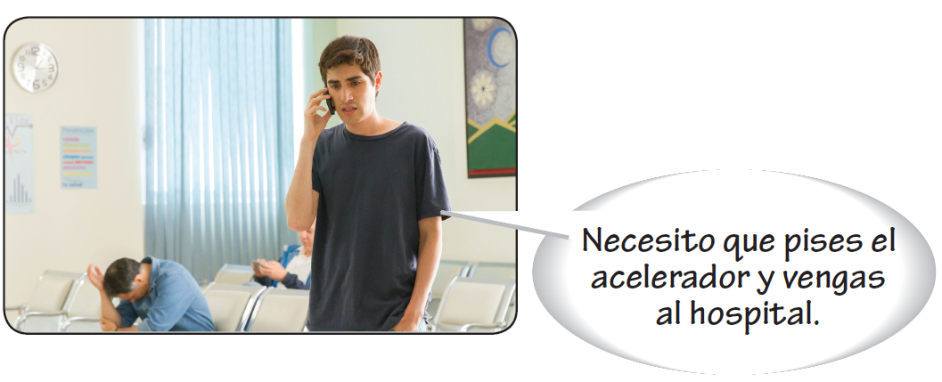
The subjunctive in noun clauses
Verbs of will and influence
A clause is a group of words that contains both a conjugated verb and a subject (expressed or implied). In a subordinate noun clause (oración subordinada sustantiva), a group of words function together as a noun.

Slide 8
The subjunctive in noun clauses
When the subject of the main (independent) clause of a sentence exerts influence or will on the subject of the subordinate clause, the verb in the subordinate clause takes the subjunctive.
MAIN CLAUSE | CONNECTOR | SUBORDINATE CLAUSE
Yo quiero | que | tú vayas al médico.

Slide 9
The subjunctive in noun clauses
Verbs and expressions of will and influence
aconsejar to advise desear to desire; to wish es importante it’s important es necesario it’s necessary es urgente it’s urgent exigir to demand | gustar to like hacer to make importar to be important insistir en to insist (on) mandar to order necesitar to need oponerse a to oppose pedir (e:i) to ask for; to request | preferir (e:ie) to prefer prohibir to prohibit proponer to propose querer (e:ie) to want; to wish recomendar (e:ie) to recommend rogar (o:ue) to beg sugerir (e:ie) to suggest
Necesito que consigas estas pastillas en la farmacia.
I need you to get these pills at the pharmacy.
Insisto en que vayas a la sala de emergencias.
I insist that you go to the emergency room.
El médico siempre me recomienda que deje de fumar.
The doctor always recommends that I quit smoking.
Se oponen a que salgas si estás enfermo.
They object to your going out if you’re sick.

Slide 10
The subjunctive in noun clauses
¡ATENCIÓN!
Pedir is used with the subjunctive to ask someone to do something.
Preguntar is used to ask questions, and is not followed by the subjunctive.
No te pido que lo hagas ahora. I’m not asking you to do it now. | No te pregunto si lo haces ahora. I’m not asking you if you’re doing it now.

Slide 11
The subjunctive in noun clauses
The infinitive, not the subjunctive, is used with verbs and expressions of will and influence if there is no change of subject in the sentence. The que is unnecessary in this case.
Quiero ir a Bogotá en junio. I want to go to Bogotá in June. | Prefiero que vayas en agosto. I prefer that you go in August.

Slide 12
The subjunctive in noun clauses
Verbs of emotion
When the main clause expresses an emotion like hope, fear, joy, pity, or surprise, the verb in the subordinate clause must be in the subjunctive if its subject is different from that of the main clause.
Espero que te recuperes pronto. I hope you recover quickly. | Qué pena que necesites una operación. What sa shame you need an operation..

Slide 13
The subjunctive in noun clauses
Verbs and expressions of emotion
alegrarse (de) to be happy (about) es bueno it’s good es extraño it’s strange es malo it’s bad es mejor it’s better es ridículo it’s ridiculous | es terrible it’s terrible es una lástima it’s a shame es una pena it’s a pity esperar to hope; to wish gustar to like; to be pleasing | molestar to bother sentir (e:ie) to be sorry; to regret sorprender to surprise temer to fear tener miedo a/de to be afraid (of)

Slide 14
The subjunctive in noun clauses
¡ATENCIÓN!
The subjunctive is also used with expressions of emotion that begin with ¡Qué…! (What a…!/It’s so…!)
¡Qué pena que él no vaya! What a shame he’s not going!
●   
The expression ojalá (I hope; I wish) is always followed by the subjunctive. The use of que with ojalá is optional.
Ojalá (que) no llueva. I hope it doesn’t rain. | Ojalá (que) no te enfermes. I hope you don’t get sick.

Slide 15
The subjunctive in noun clauses
The infinitive, not the subjunctive, is used with verbs and expressions of doubt or denial if there is no change in the subject of the sentence.
No me gusta llegar tarde. I don’t like to arrive late. | Es mejor que lo hagas ahora. It’s better that you do it now.

Slide 16
The subjunctive in noun clauses
Verbs of doubt or denial
When the main clause implies doubt, uncertainty, or denial, the verb in the subordinate clause must be in the subjunctive if its subject is different from that of the main clause.
No creo que él nos quiera engañar. I don’t think that he wants to deceive us. | Dudan que el jarabe sea un buen tratamiento. They doubt that the syrup would be a good treatment.

Slide 17
The preterite vs. the imperfect
Verbs and expressions of doubt and denial
dudar to doubt es imposible it’s imposible es improbable it’s improbable es poco seguro it’s uncertain (no) es posible it’s (not) posible (no) es probable it’s (not) probable | negar (e:ie) to deny no creer not to believe no es evidente it’s not evident no es seguro it’s not certain no es verdad/cierto it’s not true no estar seguro de not to be sure (of )

Slide 18
The preterite vs. the imperfect
The infinitive, not the subjunctive, is used with verbs and expressions of doubt or denial if there is no change in the subject of the sentence.
Es imposible viajar hoy. It’s impossible to travel today. | No es seguro que él viaje hoy. It’s not certain that he will travel today.

Slide 19
The preterite vs. the imperfect
¡ATENCIÓN!
The subjunctive is also used after quizá(s) and tal vez (maybe; perhaps) when they signal uncertainty, even if there is no change of subject in the sentence.
Quizás vengan a la fiesta.
Maybe they’ll come to the party.

