Slide 1
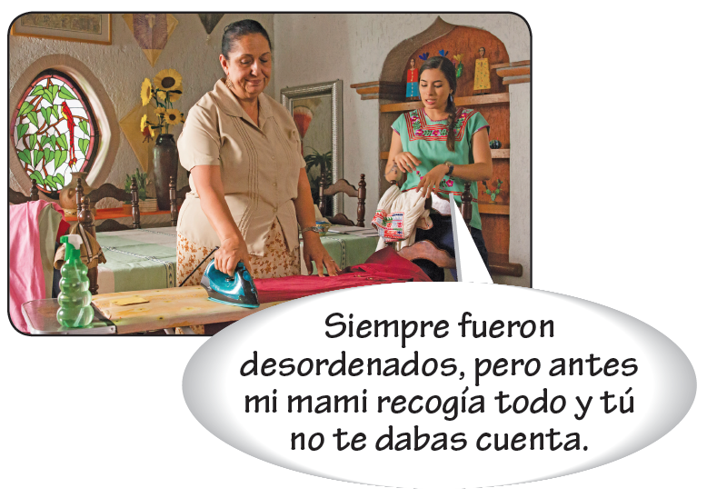
The preterite vs. the imperfect
Although the preterite and imperfect both express past actions or states, the two tenses have different uses and, therefore, are not interchangeable.

Slide 2
The preterite vs. the imperfect
Uses of the preterite
To express actions or states viewed by the speaker as completed
Reflexive verbs
Compraste esos muebles hace un mes, ¿no? | Mis amigas fueron al centro comercial ayer.
You bought that furniture a month ago, right? | My girlfriends went to the mall yesterday.

Slide 3
The preterite vs. the imperfect
To express the beginning or end of a past action
La telenovela empezó a las ocho. | El café se acabó enseguida.
The soap opera began at eight o’clock. | The coffee ran out right away

Slide 4
The preterite vs. the imperfect
To narrate a series of past actions
Me levanté, me arreglé y fui a clase. | Se setó, tomó el bolígrafo y escribió.
I got up, got ready, and went to class. | He sat down, grabbed the pen and wrote.

Slide 5
The preterite vs. the imperfect
Uses of the imperfect
To describe an ongoing past action without reference to beginning or end
Se acostaba muy temprano. | Juan tenía pesadillas constantemente.
He went to bed very early. | Juan constantly had nightmares.

Slide 6
The preterite vs. the imperfect
To express habitual past actions
Me jugaba jugar al fútbol los domingos por la mañana. | Solían comprar verduras en el mercado.
I used to liked to play soccer on Sunday mornings. | They used to buy vegetables in the market.

Slide 7
The preterite vs. the imperfect
To describe mental, physical, and emotional states or conditions
José Miguel sólo tenía quince años en aquel entonces. | Estaba tan hambriento que quería comerme un pollo entero.
José Miguel was only fifteen years old back then. | I was so hungry that I wanted to eat whole chicken.

Slide 8
The preterite vs. the imperfect
To tell time
Eran las ocho y media de la mañana. | Era la una en punto.
It was eight thirty a.m. | It was exactly one o’clock.

Slide 9
The preterite vs. the imperfect
Uses of the preterite and imperfect together
When narrating in the past, the imperfect describes what was happening, while the preterite describes the action that interrupts the ongoing activity. The imperfect provides background information, while the preterite indicates specific events that advance the plot.

Slide 10
The preterite vs. the imperfect
Había una vez un lobo que era muy pacífico y bueno. Un día, el lobo caminaba por el bosque cuando, de repente, una niña muy malvada que se llamaba Caperucita Roja apareció de entre los árboles. El lobo, asustado, comenzó a correr, pero Caperucita corría tan rápido que, al final, atrapó al lobo y se lo comió. La abuela de Caperucita no sabía lo malvada que era su nieta. Nunca nadie supo qué le pasó al pobre lobito.
Once upon a time, there was a wolf that was very peaceful and kind. One day, the wolf was walking through the forest when, all of a sudden, a very wicked little girl, who was called Little Red Riding Hood, appeared amongst the trees. The wolf, frightened, started to run, but Little Red Riding Hood was running so fast that, in the end, she caught the wolf and ate him up. Little Red Riding Hood’s grandmother didn’t know how wicked her granddaughter was. No one ever found out what happened to the poor little wolf.

Slide 11
The preterite vs. the imperfect
¡ATENCIÓN!
Here are some useful sequencing expressions.
primero | first | entonces | then
al principio | in the beginning | luego | then; next
antes (de) | before | siempre | always
después (de) | after | al final | finally
mientras | while | la última vez | the last time

Slide 12
The preterite vs. the imperfect
¡ATENCIÓN!
The imperfect progressive is also used to describe a past action that was in progress, but was interrupted by an event. Both el lobo caminaba por el bosque and el lobo estaba caminando por el bosque are correct.

Slide 13
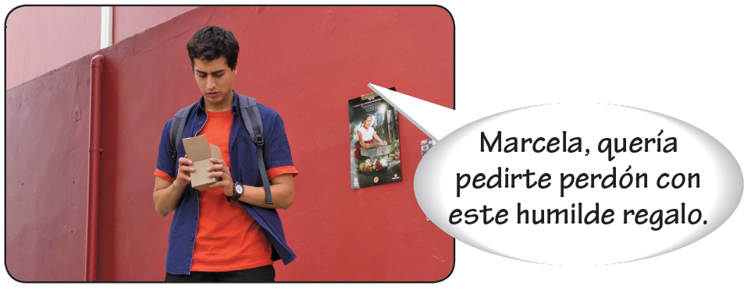
The preterite vs. the imperfect
Different meanings in the imperfect and preterite
The verbs querer, poder, saber, and conocer have different meanings when they are used in the preterite. Notice also the meanings of no querer and no poder in the preterite.

Slide 14
The preterite vs. the imperfect
INFINITIVE
IMPERFECT
PRETERITE
querer
Quería acompañarte. I wanted to go with you.
Quise acompañarte. I tried to go with you (but failed).
No quise acompañarte. I refused to go with you.
poder
Ana podía hacerlo. Ana could do it.
Ana pudo hacerlo. Ana succeeded in doing it.
Ana no pudo hacerlo. Ana could not do it.
saber
Ernesto sabía la verdad. Ernesto knew the truth.
Por fin Ernesto supo la verdad. Ernesto finally discovered the truth.
conocer
Yo ya conocía a Andrés. I already knew Andrés.
Yo conocí a Andrés en la fiesta. I met Andrés at the party.

Slide 15
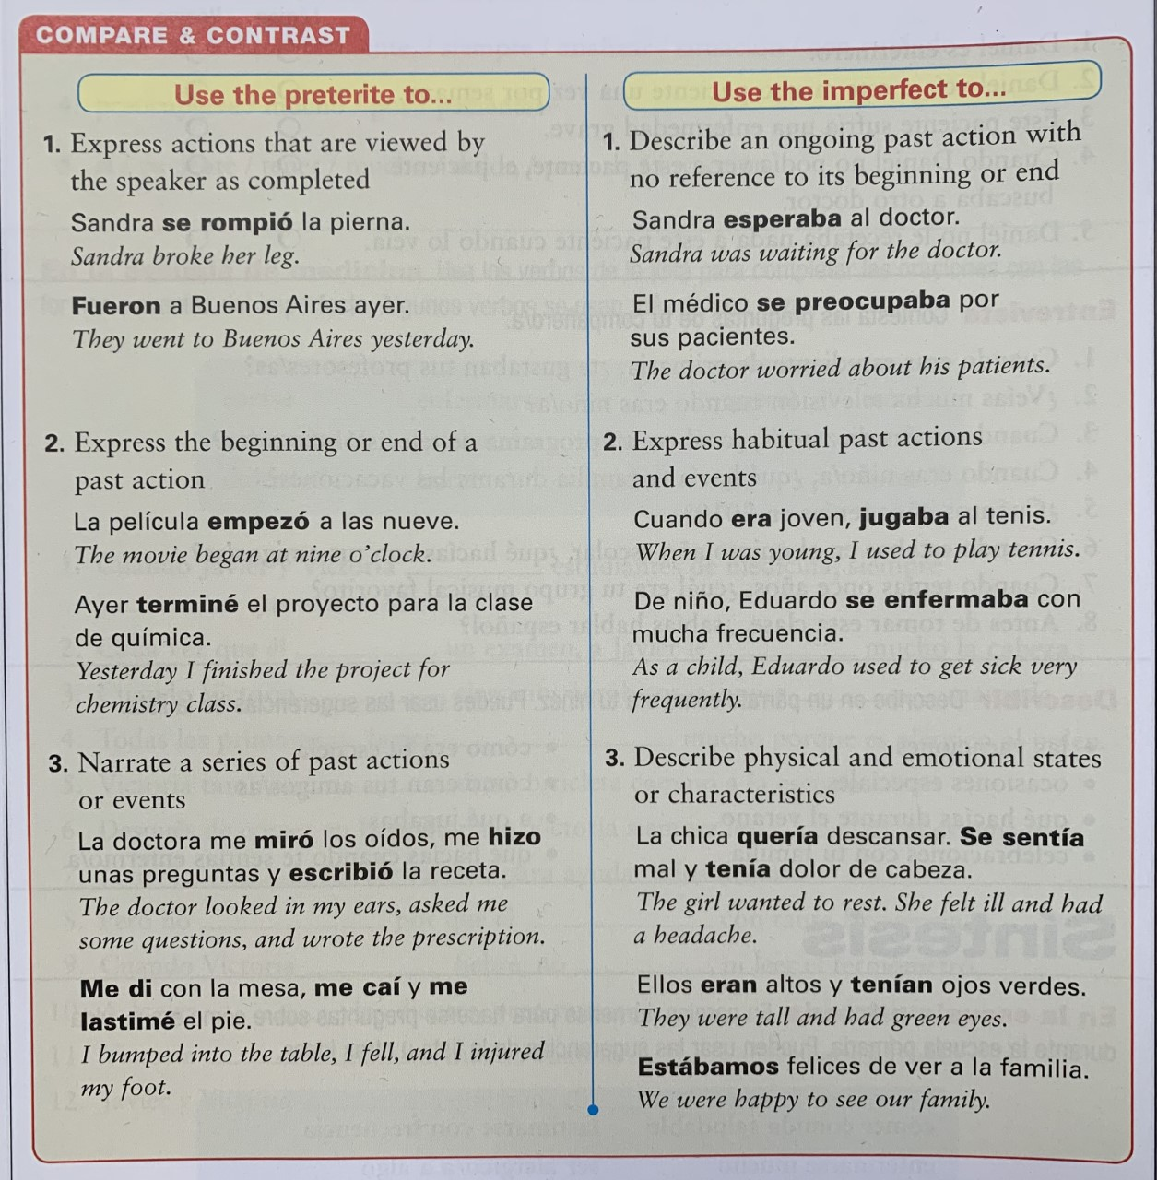

Slide 16
