Slide 1
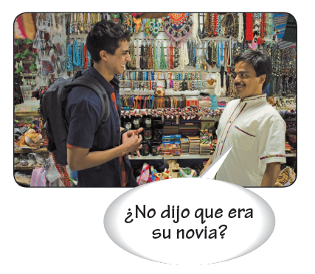
The imperfect
The imperfect tense in Spanish is used to narrate past events without focusing on their beginning, end, or completion.

Slide 2
The imperfect
The imperfect tense of regular verbs is formed by dropping the infinitive ending (-ar, -er, -ir) and adding personal endings. -Ar verbs take the endings -aba, -abas, -aba, -ábamos, -abais, -aban. -Er and -ir verbs take -ía, -ías, -ía, -íamos, -íais, -ían.
Reflexive verbs
The imperfect of regular -ar, -er, and -ir verbs
caminar | deber | abrir
caminaba caminabas caminaba caminábamos caminabais caminaban | debía debías debía debíamos debíais debían | abría abrías abría abríamos abríais abrían

Slide 3
The imperfect
Ir, ser, and ver are the only verbs that are irregular in the imperfect.
The imperfect of irregular verbs
ir | ser | ver
iba ibas iba íbamos ibais iban | era eras era éramos erais eran | veía veías veía veíamos veíais veían

Slide 4
The imperfect
The imperfect tense narrates what was going on at a certain time in the past. It often indicates what was happening in the background.
Cuando yo era joven, vivía en una ciudad muy grande. Todas las semanas, mis padres y yo íbamos al centro comercial.
When I was young, I lived in a big city. Every week, my parents and I went to the mall.

Slide 5
The imperfect
The imperfect of hay is había.
Había tres cajeras en el supermercado.
There were three cashiers in the supermarket.
Sólo había un mesero en el café.
There was only one waiter in the café.

Slide 6
The imperfect
These words and expressions are often used with the imperfect because they express habitual or repeated actions: de niño/a (as a child), todos los días (every day), mientras (while), siempre (always).
De niño, vivía en un barrio de Madrid.
As a child, I lived in a Madrid neighborhood.
Todos los días iba a la casa de mi abuela.
Every day I went to my grandmother’s house.
Siempre escuchaba música mientras corría en el parque.
I always listened to music while I ran in the park.

Slide 7
The imperfect

