Slide 1
Numbers 31 and higher
You have already learned numbers 0–30. Now you will learn the rest of the numbers.

Slide 2
Numbers 31 and higher
Numbers 31–100
Numbers 31–99 follow the same basic pattern as 21–29.
Numbers 31–100
31 treinta y uno 32 treinta y dos 33 treinta y tres 34 treinta y cuatro 35 treinta y cinco 36 treinta y seis 37 treinta y siete 38 treinta y ocho 39 treinta y nueve | 40 cuarenta 41 cuarenta y uno 42 cuarenta y dos 43 cuarenta y tres 44 cuarenta y cuatro 45 cuarenta y cinco 46 cuarenta y seis 47 cuarenta y siete 48 cuarenta y ocho 49 cuarenta y nueve | 50 cincuenta 51 cincuenta y uno 52 cincuenta y dos 60 sesenta 63 sesenta y tres 64 sesenta y cuatro 70 setenta 80 ochenta 90 Noventa 100 cien, ciento

Slide 3
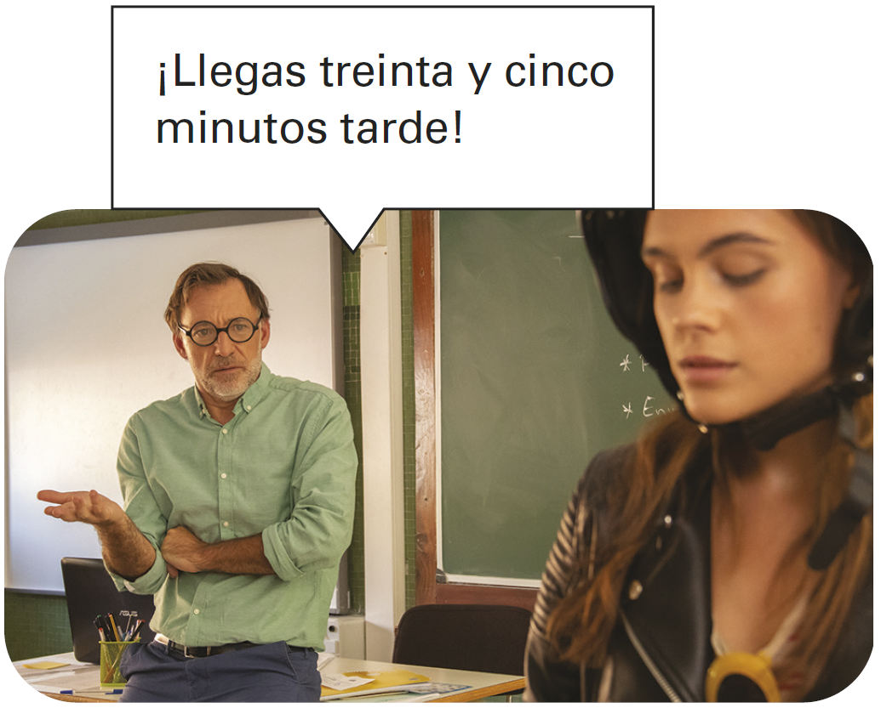
Numbers 31 and higher
Y is used in most numbers from 31 through 99. Unlike numbers 21–29, these numbers must be written as three separate words.
Hay noventa y dos exámenes. There are ninety-two exams. | Hay cuarenta y dos estudiantes. There are forty-two students.

Slide 4
Numbers 31 and higher
With numbers that end in uno (31, 41, etc.), uno becomes un before a masculine noun and una before a feminine noun.
Hay treinta y un chicos. There are thirty-one guys. | Hay treinta y una chicas. There are thirty-one girls.

Slide 5
Numbers 31 and higher
Cien is used before nouns and in counting. The words un, una, and uno are never used before cien in Spanish. Use cientos to say hundreds.
Hay cien libros y cien sillas. There are one hundred books and one hundred chairs. | ¿Cuántos libros hay? Cientos. How many books are there? Hundreds.

Slide 6
Numbers 31 and higher
Numbers 101 and higher
As shown in the chart, Spanish uses a period to indicate thousands and millions, rather than a comma as is used in English.
Numbers 101 and higher
101 ciento uno 200 doscientos/as 300 trescientos/as 400 cuatrocientos/as 500 quinientos/as 600 seiscientos/as 700 setecientos/as 800 ochocientos/as 900 novecientos/as | 1.000 mil 1.100 mil cien 2.000 dos mil 5.000 cinco mil 100.000 cien mil 200.000 doscientos/as mil 550.000 quinientos/as cincuenta mil 1.000.000 un millón (de) 8.000.000 ocho millones (de)

Slide 7
Numbers 31 and higher
Notice that you should use ciento, not cien, to count numbers over 100.
110 = ciento diez 118 = ciento dieciocho 150 = ciento cincuenta

Slide 8
Numbers 31 and higher
The numbers 200 through 999 agree in gender with the nouns they modify.
324 plumas trescientas veinticuatro plumas | 605 libros seiscientos cinco libros

Slide 9
Numbers 31 and higher
The word mil, which can mean a thousand and one thousand, is not usually used in the plural form to refer to an exact number, but it can be used to express the idea of a lot, many, or thousands. Cientos can also be used to express hundreds in this manner.
¡Hay miles de personas en el estadio! There are thousands of people in the stadium. | Hay cientos de libros en la biblioteca. There are hundreds of books in the library.

Slide 10
Numbers 31 and higher
To express a complex number (including years), string together all of its components.
55.422 cincuenta y cinco mil cuatrocientos veintidós

Slide 11
Numbers 31 and higher
¡INTÉNTALO!
Write out the Spanish equivalent of each number.
1. 102 ______________________________ 2. 5.000.000 _________________________ 3. 201 ______________________________ 4. 76 _______________________________ 5. 92 _______________________________ 6. 550.300 __________________________ | 7. 235 ______________________________ 8. 79 _______________________________ 9. 113 ______________________________ 10. 88 _______________________________ 11. 17.123 ___________________________ 12. 497 ______________________________
ciento dos

