Slide 1
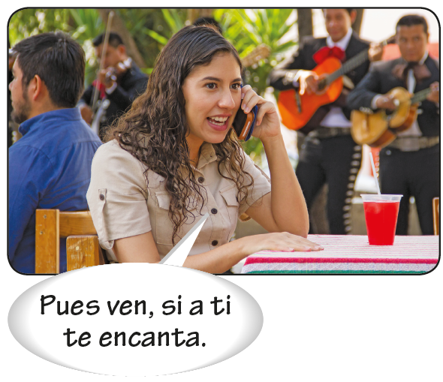
Gustar and similar verbs

Slide 2
Gustar and similar verbs
Though gustar is translated as to like in English, its literal meaning is to please. Gustar is preceded by an indirect object pronoun indicating the person who is pleased. It is followed by a noun indicating the thing or person that pleases.
INDIRECT OBJECT
PRONOUN
SUBJECT
Me I ¿Te Do you | gusta like gustan like | la película. the movie. (literally: The movie pleases me.) los conciertos de rock? rock concerts? (literally: Do rock concerts please you?)

Slide 3
Gustar and similar verbs
Because the thing or person that pleases is the subject, gustar agrees in person and number with it. Most commonly the subject is third person singular or plural.
SINGULAR SUBJECT
PLURAL SUBJECT
Nos gusta la música pop. We like pop music. | Me gustan las quesadillas. I like quesadillas.
Les gusta su casa nueva. They like their new house. | ¿Te gustan las películas románticas? Do you like romantic movies?

Slide 4
Gustar and similar verbs
When gustar is followed by one or more verbs in the infinitive, the singular form of gustar is always used.
No nos gusta llegar tarde. We don’t like to arrive late. | Les gusta cantar y bailar. They like to sing and dance.

Slide 5
Gustar and similar verbs
Gustar is often used in the conditional (me gustaría, etc.) to soften a request.
Me gustaría un refresco con hielo, por favor. I would like a soda with ice, please. | ¿Te gustaría salir a cenar esta noche conmigo? Would you like to go out to dinner with me tonight?

Slide 6
Gustar and similar verbs
Verbs like gustar
Many verbs follow the same pattern as gustar.
aburrir to bore caer bien/mal to (not) get along well with disgustar to upset doler to hurt; to ache encantar to like very much faltar to lack; to need fascinar to fascinate; to like very much | hacer falta to miss importar to be important to; to matter interesar to be interesting to; to interest molestar to bother; to annoy preocupar to worry quedar to be left over; to fit (clothing) sorprender to surprise
¡Me fascina el álbum! I love the album! A Sandra le disgusta esa situación. That situation upsets Sandra. | ¿Te molesta si voy contigo? Will it bother you if I come along? Le duelen las rodillas. Her knees hurt.

Slide 7
Gustar and similar verbs
The indirect object can be repeated using the construction a + [prepositional pronoun] or
a + [noun]. This construction allows the speaker to emphasize or clarify who is pleased,
bothered, etc.
A ella no le gusta bailar, pero a él sí. She doesn’t like to dance, but he does. | A Felipe le molesta ir de compras. Shopping bothers Felipe.

Slide 8
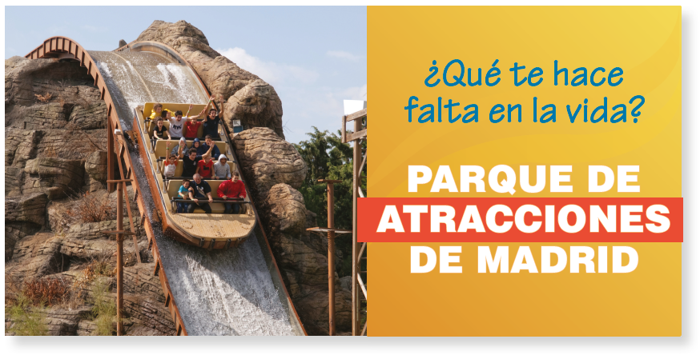
Gustar and similar verbs
Faltar expresses what someone or something lacks and quedar what someone or something has left. Quedar is also used to talk about how clothing fits or looks on someone.
Le falta dinero. He’s short of money. A la impresora no le queda papel. The printer is out of paper. | Me faltan dos pesos. I need two pesos. Esa falda te queda bien. That skirt fits you well.

