Slide 1
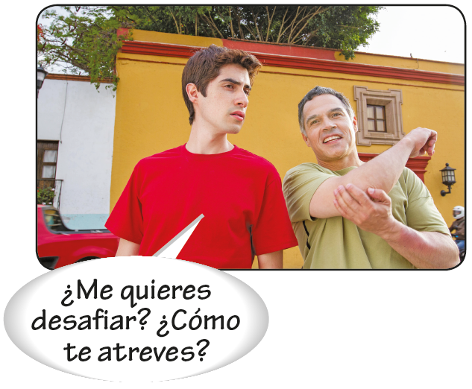
Object pronouns
Pronouns are words that take the place of nouns. Direct object pronouns replace the noun that directly receives the action of the verb. Indirect object pronouns identify to whom/what or for whom an action is done.
Indirect object pronouns |  | Direct object pronouns
me te le | nos os les | me te lo/la | nos os los/las

Slide 2
Object pronouns
¡ATENCIÓN!
Lo can be used to refer to a thing or idea that has
no gender.
—¿Vas a aceptar la oferta?
—Lo voy a pensar.
—Are you going to accept the offer?
—I’ll think about it.

Slide 3
Object pronouns
Position of object pronouns
Direct and indirect object pronouns (los pronombres de complemento directo e indirecto) precede the conjugated verb.
INDIRECT OBJECT
DIRECT OBJECT
Carla siempre me da entradas para el teatro. | Ella las consigue gratis.
Carla always gives me theater tickets. | She gets them for free.
No le compro más juegos de mesa. | Nunca los juega.
I’m not buying him any more board games. | He never plays them.

Slide 4
Object pronouns
When the verb is an infinitive construction, object pronouns may either be attached to the
infinitive or placed before the conjugated verb.
INDIRECT OBJECT
DIRECT OBJECT
Vamos a darle un regalo. Le vamos a dar un regalo. Tienes que hablarnos de la película. Nos tienes que hablar de la película. | Voy a hacerlo enseguida. Lo voy a hacer enseguida. Van a verla mañana. La van a ver mañana.

Slide 5
Object pronouns
When the verb is progressive form, object pronouns may either be attached to the present participle or placed before the conjugated verb.
INDIRECT OBJECT
DIRECT OBJECT
Pedro está cantándome una canción. Pedro me está cantando una canción. | Está cantándola muy mal. La está cantando muy mal.

Slide 6
Object pronouns
¡ATENCIÓN!
It is standard usage in Spanish to repeat the indirect object.
Esta noche le voy a quitar la camisa al guitarrista.
Les regalé boletos a mis amigos.

Slide 7
Object pronouns
Double object pronouns
The indirect object pronoun precedes the direct object pronoun when they are used together in a sentence.
Me mandaron los boletos por correo. Te exijo una respuesta ahora mismo. | Me los mandaron por correo. Te la exijo ahora mismo.

Slide 8
Object pronouns
Le and les change to se when they are used with lo, la, los, or las.
Le da los libros a Ricardo. Le enseña las invitaciones a Elena. | Se los da. Se las enseña.

Slide 9
Object pronouns
¡ATENCIÓN!
When object pronouns are attached to infinitives, participles, or commands, a written accent is often required to maintain proper word stress.
Infinitive cantármela
Present participle escribiéndole
Command acompáñeme
For more information on using object pronouns with commands, see 4.2, pp. 160–161.

Slide 10
Object pronouns
Prepositional pronouns
Prepositional pronouns
mí me; myself ti you; yourself Ud. you; yourself sí yourself (formal) | él him; it ella her; it sí himself; herself; itself | nosotros/as us; ourselves vosotros/as you; yourselves Uds. you; yourselves sí yourselves (formal) | ellos them ellas them sí themselves
Prepositional pronouns function as the objects of prepositions. Except for mí, ti, and sí, these pronouns are the same as the subject pronouns.
¿Qué piensas de ella? Ay, mi amor, sólo pienso en ti. | ¿Lo compraron para mí o para Javier? Lo compramos para él.

Slide 11
Object pronouns
The indirect object can be repeated with the construction a + [prepositional pronoun] to provide clarity or emphasis.
¿Te gusta aquel cantante? | ¡A mí me fascina!
¿A quién se lo dieron? | Se lo dieron a ella.

Slide 12
Object pronouns
The adjective mismo(s)/a(s) is usually added to clarify or emphasize the relationship between the subject and the object.
José se lo regaló a él. José gave it to him (someone else). | José se lo regaló a sí mismo. José gave it to himself.

Slide 13
Object pronouns
When mí, ti, and sí are used with con, they become conmigo, contigo, and consigo.
¿Quieres ir conmigo al parque de atracciones? Do you want to go to the amusement park with me? Laura siempre lleva su computadora portátil consigo. Laura always brings her laptop with her.

Slide 14
Object pronouns
These prepositions are used with tú and yo instead of mí and ti: entre, excepto, incluso, menos, salvo, según.
Todos están de acuerdo menos tú y yo. Everyone is in agreement except you and me. | Entre tú y yo, Juan me cae mal. Between you and me, I don’t get along well with Juan.

