Slide 1
Present tense of -ar verbs
In order to talk about activities, you need to use verbs. Verbs express actions or states of being. In English and Spanish, the infinitive is the base form of the verb. In English, the infinitive is preceded by the word to: to study, to be. The infinitive in Spanish is a one-word form and can be recognized by its endings: -ar, -er, or -ir.
-ar verb
-er verb
-ir verb
estudiar | to study | comer | to eat | escribir | to write

Slide 2
Present tense of -ar verbs
In this lesson, you will learn the forms of regular -ar verbs.
The verb estudiar (to study)
yo | estudio | I study
tú | estudias | you (fam.) study
Ud./él / ella | estudia | you (form.) study; he/she studies
nosotros/as | estudiamos | we study
vosotros/as | estudiáis | you (fam.) study
Uds./ellos/ellas | estudian | you (form.) study; they study
SINGULAR FORMS
PLURAL
FORMS

Slide 3
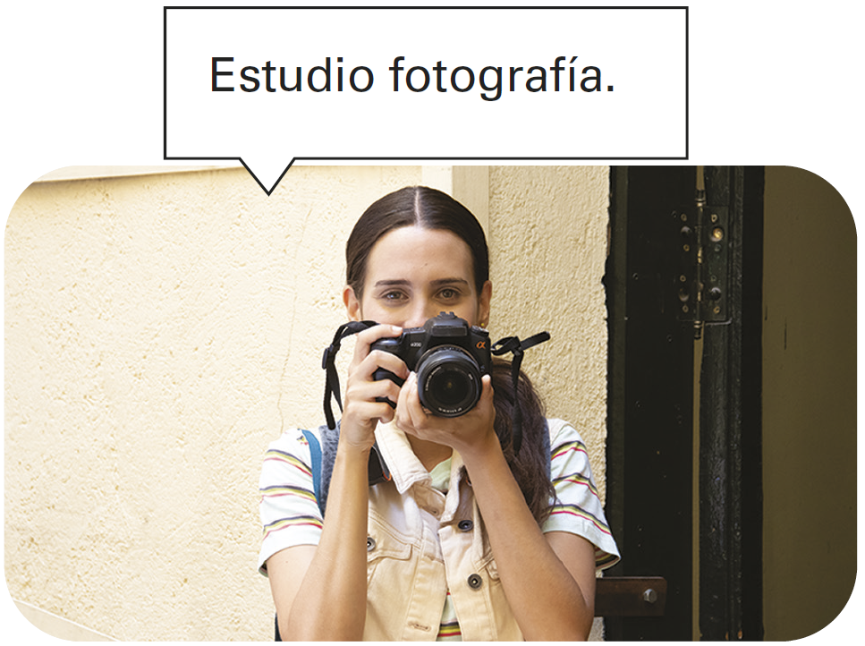
Present tense of -ar verbs

Slide 4
Present tense of -ar verbs
To create the forms of most regular verbs in Spanish, drop the infinitive endings (-ar, -er, -ir). You then add to the stem the endings that correspond to the different subject pronouns. This diagram will help you visualize verb conjugation.
Conjugation of -ar verbs
INFINITIVE
VERB STEM
CONJUGATED FORM
estudiar
bailar
trabajar
estudi-
bail-
trabaj-
yo estudio
tú bailas
nosotros trabajamos

Slide 5
Present tense of -ar verbs
Common -ar verbs
bailar buscar caminar cantar cenar comprar contestar conversar desayunar descansar desear (+ inf.) dibujar enseñar escuchar esperar (+ inf.) | to dance to look for to walk to sing to have dinner to buy to answer to converse, to chat to have breakfast to rest to desire; to wish to draw to teach to listen (to) to wait (for); to hope | estudiar explicar hablar llegar llevar mirar necesitar (+ inf.) practicar preguntar preparar regresar terminar tomar trabajar viajar | to study to explain to talk; to speak to arrive to carry to look (at); to watch to need to practice to ask (a question) to prepare to return to end; to finish to take; to drink to work to travel

Slide 6
Present tense of -ar verbs
¡Atención! Unless referring to a person, the Spanish verbs buscar, escuchar, esperar, and mirar do not need to be followed by prepositions as they do in English.
Busco la tarea. I’m looking for the homework. Espero el autobús. I’m waiting for the bus. | Escucho la música. I’m listening to the music. Miro la pizarra. I’m looking at the blackboard

Slide 7
Present tense of -ar verbs
COMPARE & CONTRAST
English uses three sets of forms to talk about the present: (1) the simple present (Paco works), (2) the present progressive (Paco is working), and (3) the emphatic present (Paco does work). In Spanish, the simple present can be used in all three cases.
 | 1. Paco works in the cafeteria.
Paco trabaja en la cafetería. | 2. Paco is working in the cafeteria.
 | 3. Paco does work in the cafeteria.
In Spanish and English, the present tense is also sometimes used to express future action.
 | 1. Marina travels to Madrid tomorrow.
Marina viaja a Madrid mañana. | 2. Marina will travel to Madrid tomorrow.
 | 3. Marina is traveling to Madrid tomorrow.

Slide 8
Present tense of -ar verbs
When two verbs are used together with no change of subject, the second verb is generally in the infinitive. To make a sentence negative in Spanish, the word no is placed before the conjugated verb. In this case, no means not.
Deseo hablar con el señor Díaz. I want to speak with Mr. Díaz. | Alicia no desea bailar ahora. Alicia doesn’t want to dance now.

Slide 9
Present tense of -ar verbs
Spanish speakers often omit subject pronouns because the verb endings indicate who the subject is. In Spanish, subject pronouns are used for emphasis, clarification, or contrast.
—¿Qué enseñan? What do they teach? —¿Quién desea trabajar hoy? Who wants to work today? | —Ella enseña arte y él enseña física. She teaches art, and he teaches physics. —Yo no deseo trabajar hoy. I don’t want to work today.

Slide 10
Present tense of -ar verbs
The verb gustar
Gustar is different from other -ar verbs. To express your likes and dislikes, use the expression (no) me gusta + el/la + [singular noun] or (no) me gustan + los/las + [plural noun].
Note: You may use the phrase a mí for emphasis, but never the subject pronoun yo.
Me gusta la música clásica. I like classical music. A mí me gustan las artes. I like the arts. | Me gustan las clases de español y biología. I like Spanish and biology classes. A mí no me gusta llegar tarde. I don’t like to be late.

Slide 11
Present tense of -ar verbs
To talk about what you like and don’t like to do, use (no) me gusta + [infinitive(s)]. Note that the singular gusta is always used, even with more than one infinitive.
No me gusta viajar en autobús. I don’t like to travel by bus. | Me gusta cantar y bailar. I like to sing and dance.

Slide 12
Present tense of -ar verbs
To ask a classmate about likes and dislikes, use the pronoun te instead of me. Note: You may use a ti for emphasis, but never the subject pronoun tú.
—¿Te gusta la geografía? Do you like geography? | —Sí, me gusta. Y a ti, ¿te gusta el inglés? Yes, I like it. And you, do you like English?

Slide 13
Present tense of -ar verbs
You can use this same structure to talk about other people by using the pronouns nos, le, and les.
Nos gusta dibujar. (nosotros) We like to draw. No le gusta trabajar. (usted, él, ella) You don’t like to work. He/She doesn’t like to work. | Nos gustan las clases de español e inglés. (nosotros) We like Spanish class and English class. Les gusta el arte. (ustedes, ellos, ellas) You like art. ¿They like art.

Slide 14
Present tense of -ar verbs
Provide the present tense forms of these verbs. The first items have been done for you.
¡INTÉNTALO!
hablar | gustar
Yo ___________ español. Ellos ___________ español. Inés ___________ español. Nosotras ___________ español. Tú ___________ español. | 1. ___________ el café. (a mí) 2. ¿ ___________ as clases? (a ti) 3. No ___________ el café. (a ti) 4. No ___________ las clases. (a mí) 5. No ___________ el café. (a mí)
hablo
Me gusta

